Slide 1
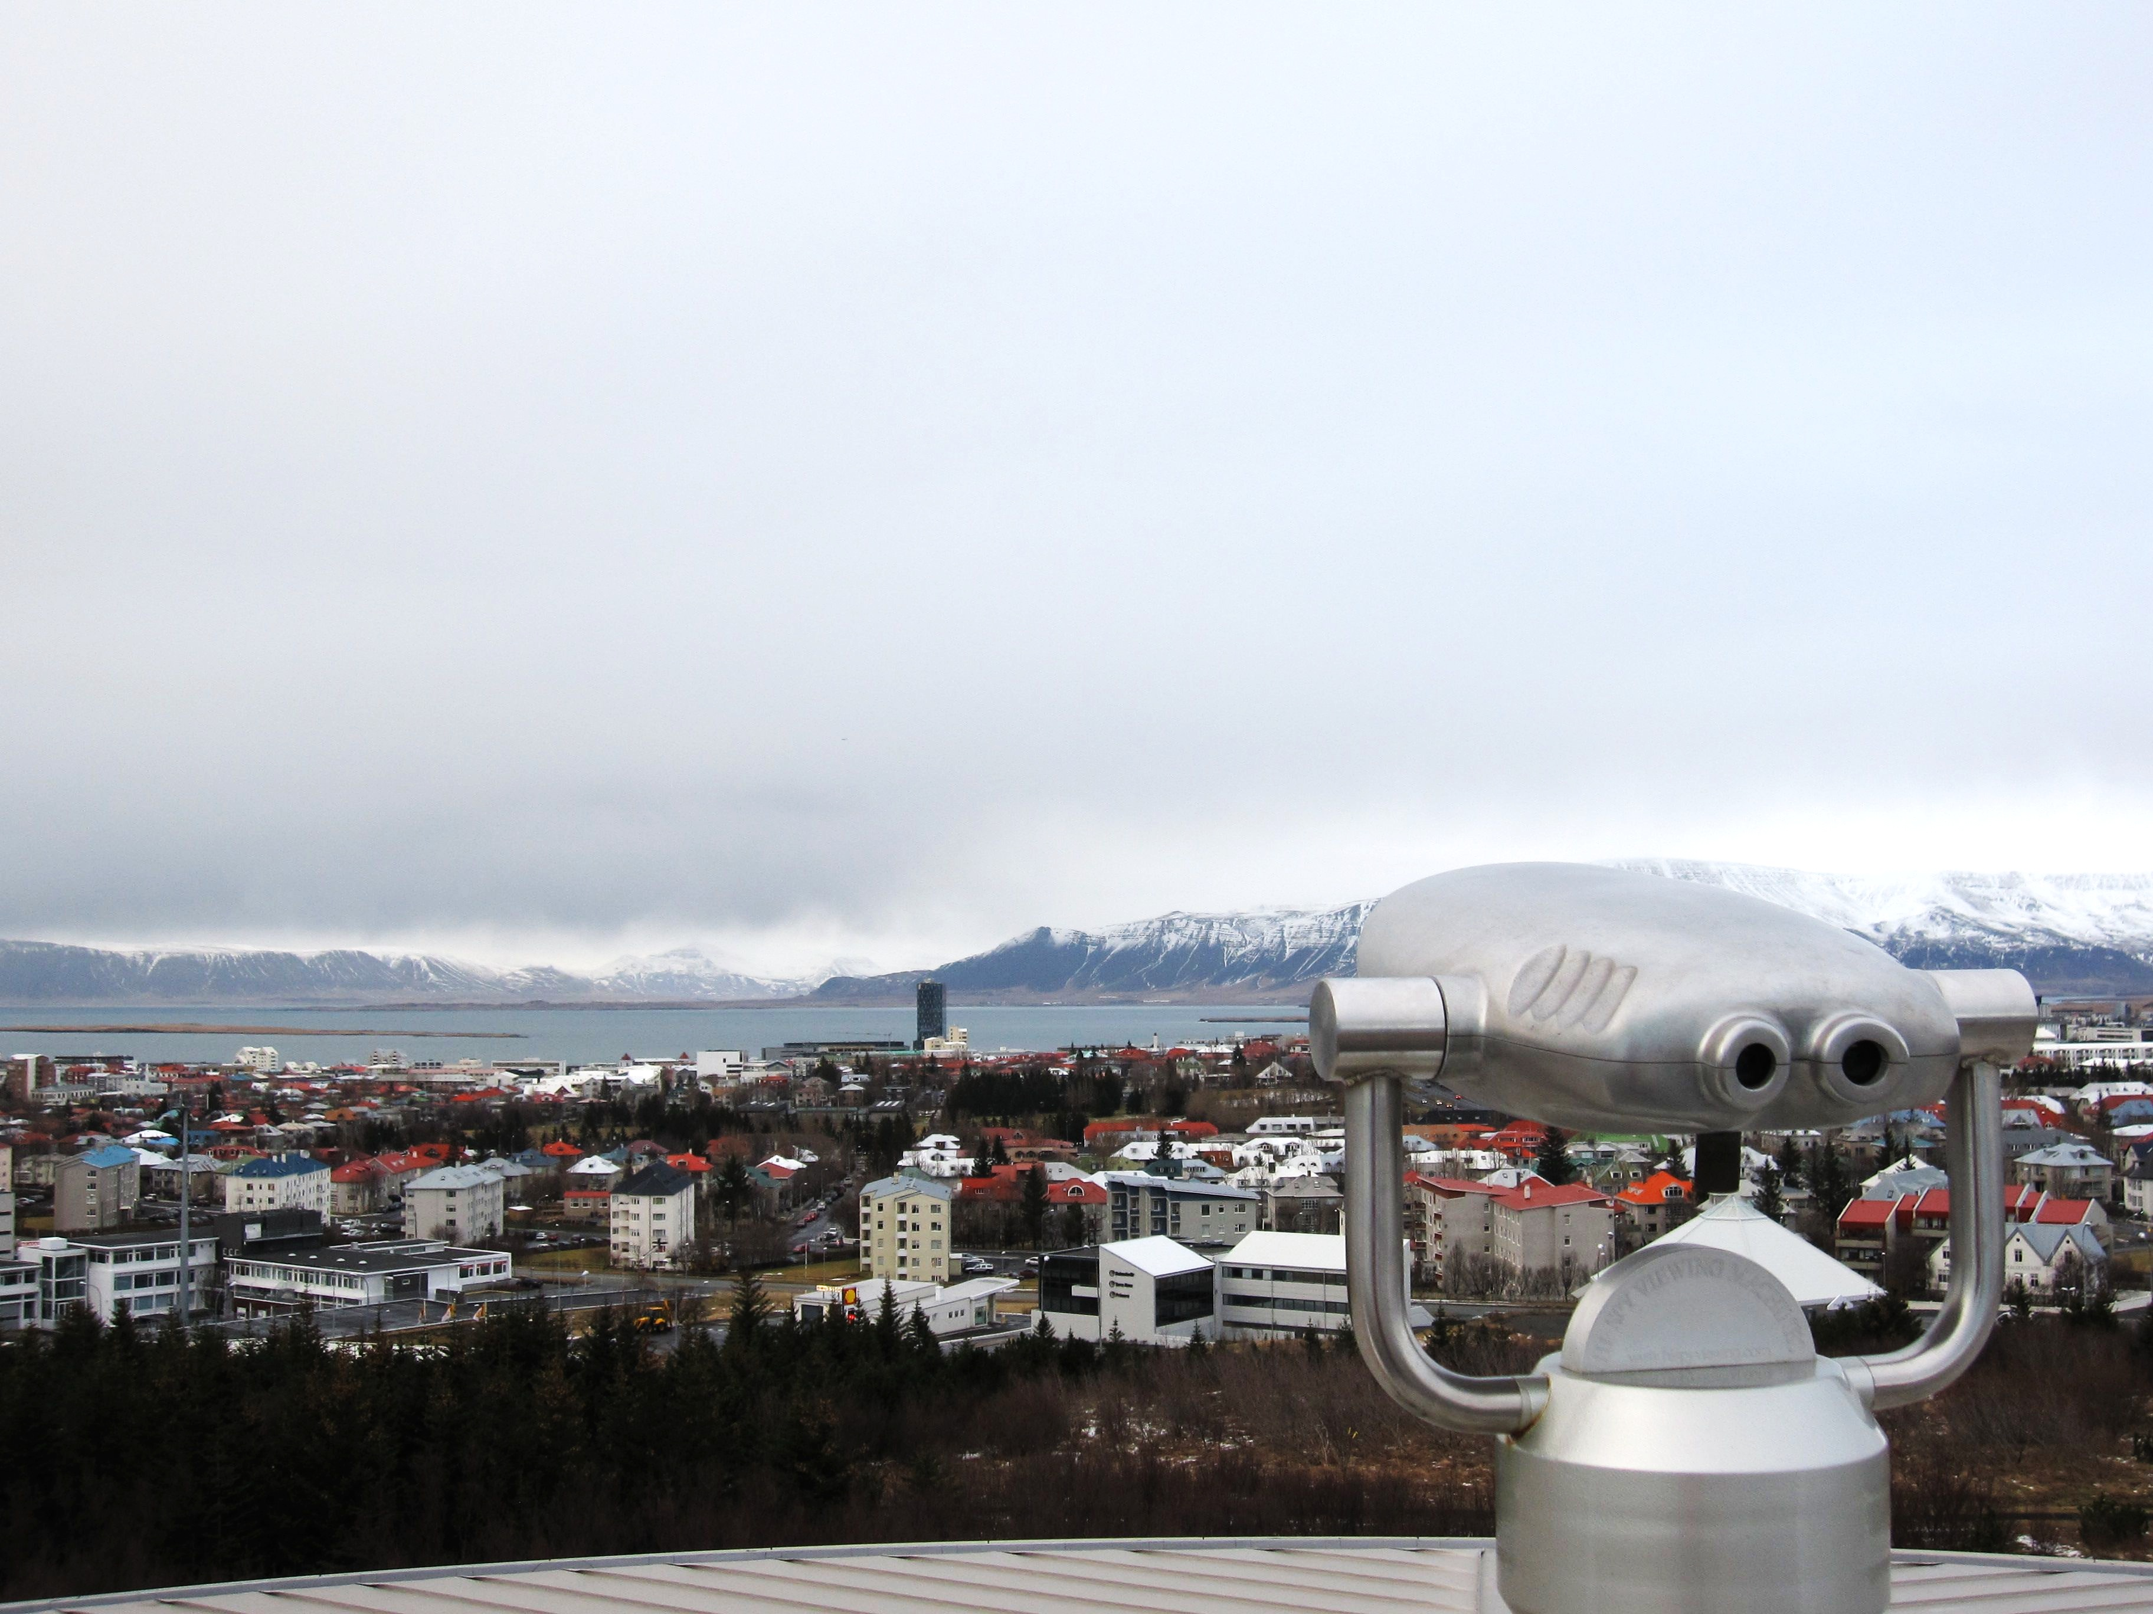
Making the Computer See
Computer Vision For Everyday Applications
Martin Jul
NDC Oslo, June 5th, 2014

Slide 2
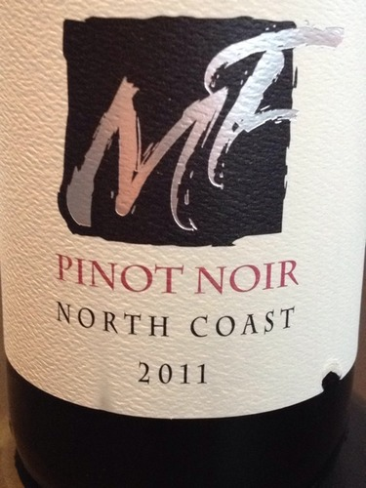
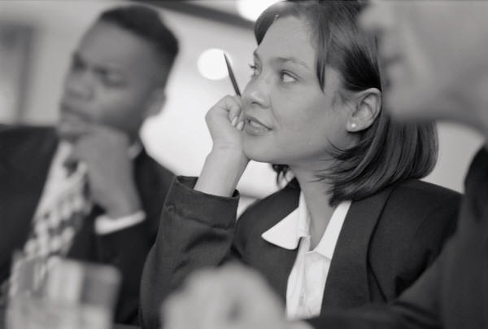

Our Habitual World…
Human Data Processing
Unstructured Data
Producer: MF
Wine: Pinot Noir
North Coast
Vintage: 2011
Machine Data Processing
Structured
Data
Notes:
Typical day at the office
We observe the world – sight, sound, …
Enter it into our database
It was good as long as machines are expensive and humans not
And it was alright until this happened….

Slide 3
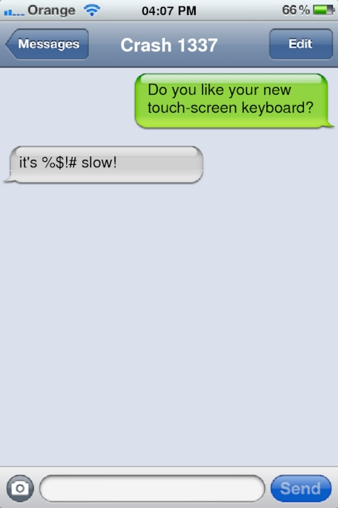
Fun?
Notes:
iPhone introduced 2007
iPad introduced 2010
---
http://ifaketext.com

Slide 4

Fun?
http://en.m.wikipedia.org
Notes:
Marketers like this, but really?
It was good in manufacturing
Maybe useful in Japan / China
Complicated character sets

Slide 5
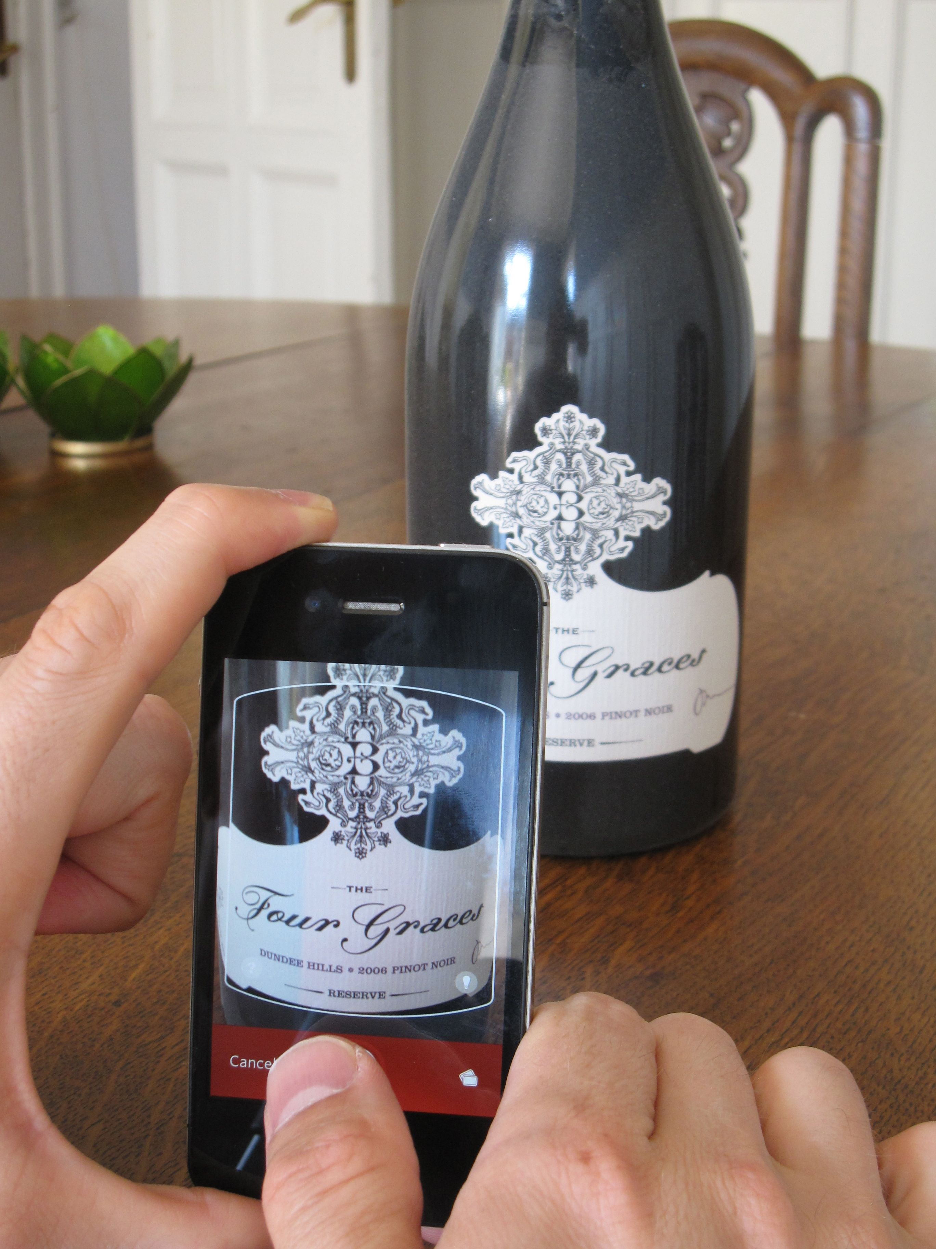
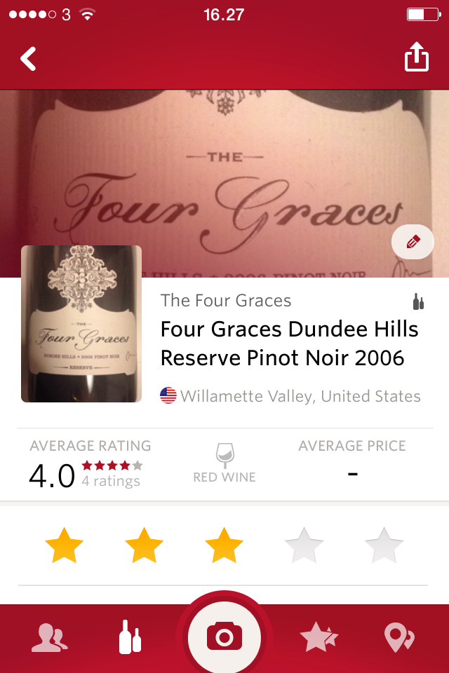
Fun!
Notes:
And then this happened!
The Vivino app recognizes the bottle from the photo
They completely eliminated typing
For me, that’s the beginning of the revolution

Slide 6
“Software is Eating the World”
Human Data Processing
Unstructured Data
Four Graces
Dundas Hills Reserve
Pinot Noir
2006
Machine Data Processing
Structured
Data
Notes:
Someone found a shortcut
If you had a fast computer with a camera in your pocket
And image processing were cheap
Then this would be better…
Seems like magic, but it is easier than most people think
Let’s see how…

Slide 7
Agenda
Historical Context
Books and Cars – the 20 mill. kroner problem
Recognizing Shapes and Geometry
Reading text from images
Pizza is Here
Object Detection
Wine
Computer Vision and Machine Learning

Slide 8
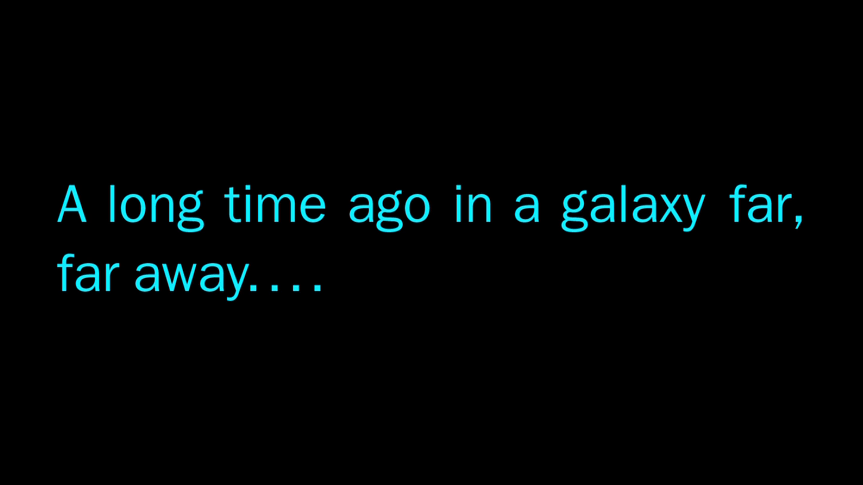
Notes:
You might think OCR like so many “modern” topics in datalogy, was discovered in the 1970es…
Who thinks earlier?
Pre-war even?
Pre-”Great War” / WW1????

Slide 9
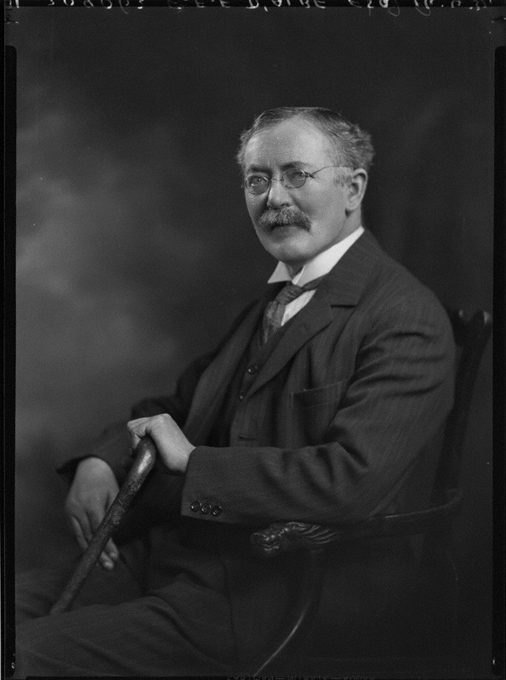
1910s
On a Type-Reading Optophone, E. E. Fournier d'Albe,
Proc. R. Soc. Lond. A 1914 90 (published 1 July 1914)
Photo from National Portrait Gallery (1932)
http://www.npg.org.uk/collections/search/person/mp97681/edmund-edward-fournier-dalbe
Notes:
Edmund Edward Fournier d’Albe
1914
Photocell and telephone relay
Text to sound

Slide 10
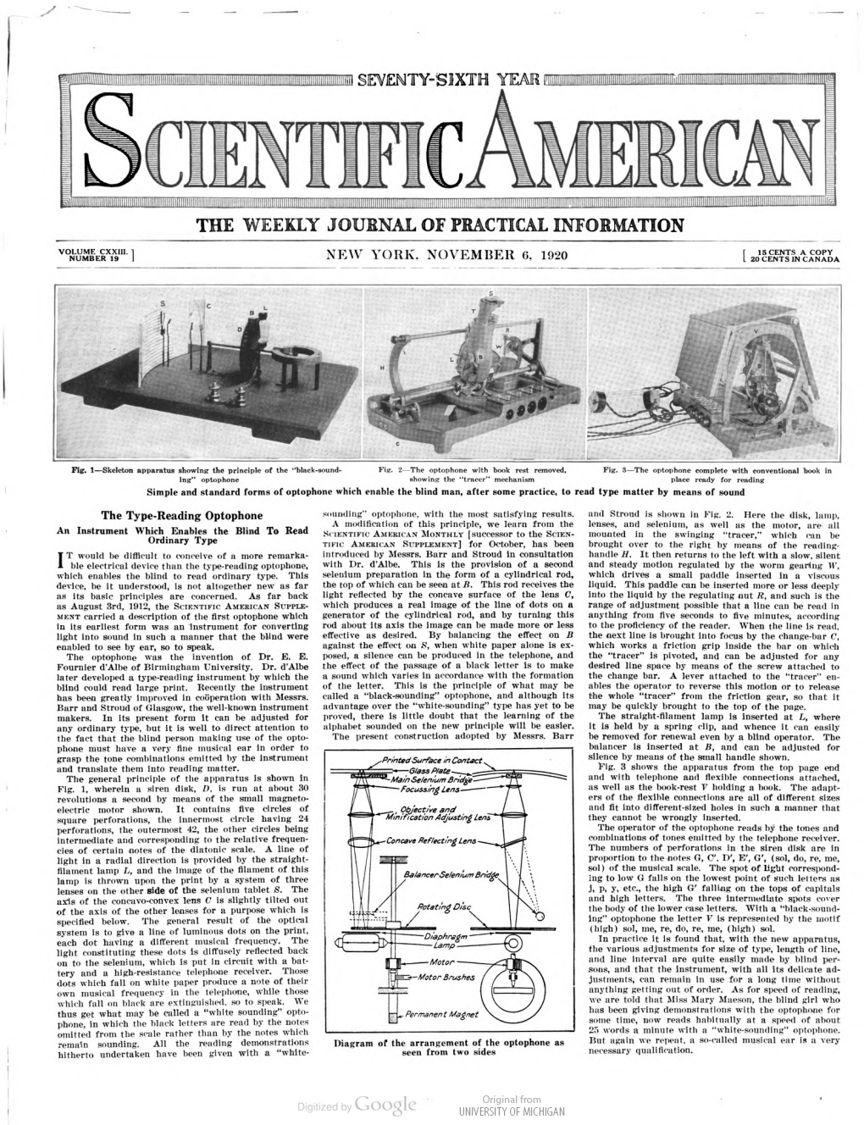
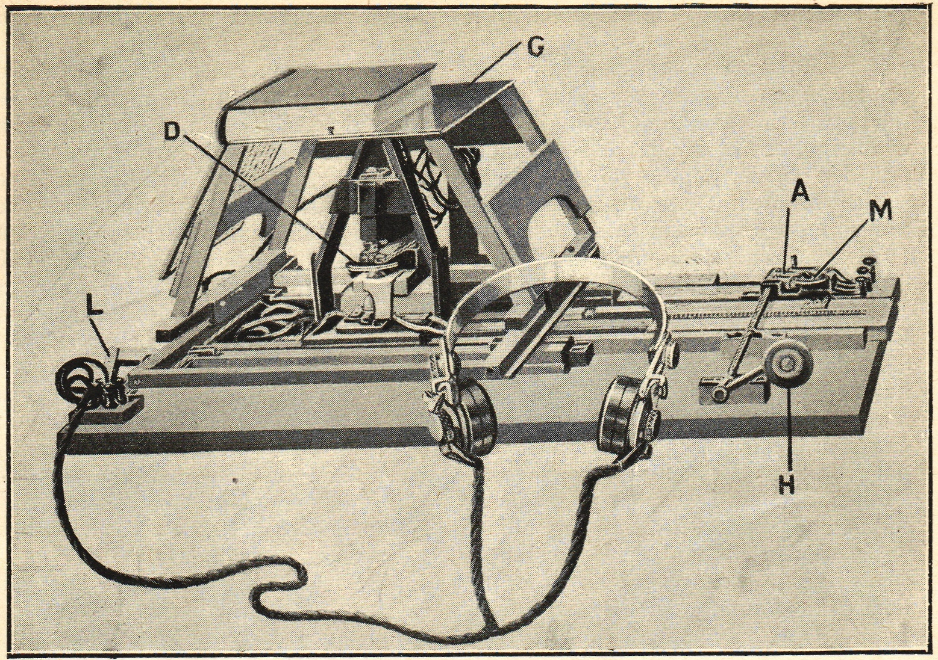
1920s
https://en.wikipedia.org/wiki/Optophone
Source: http://babel.hathitrust.org/cgi/pt?id=mdp.39015024546411;view=1up;seq=543
Notes:
1920: Developed to 25 words per minute for advanced “readers”

Slide 11
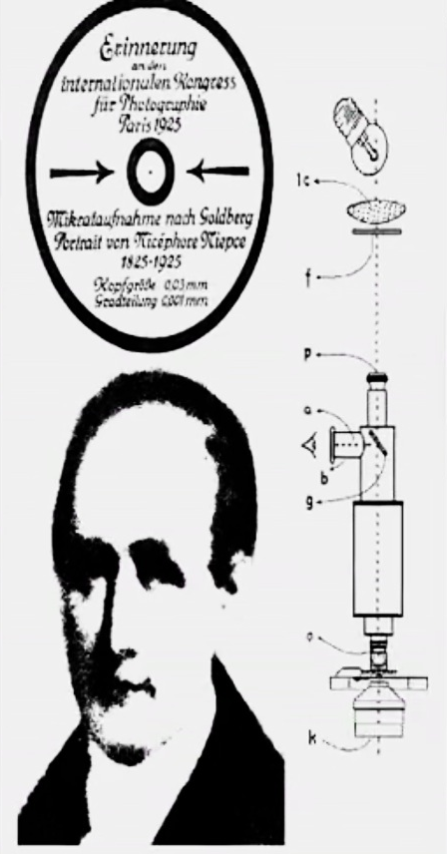
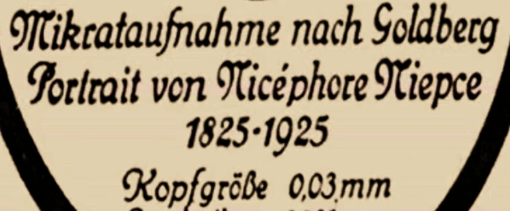
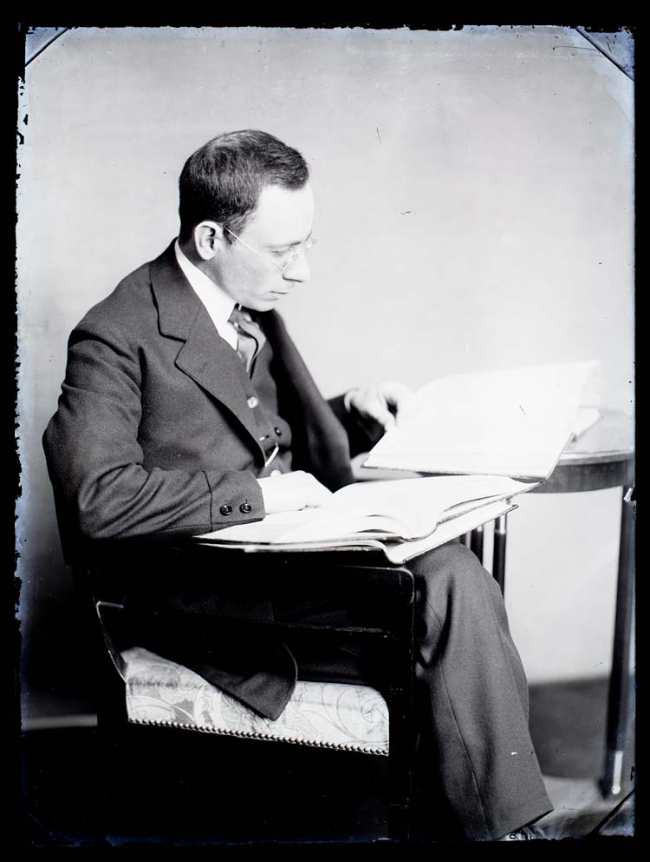
1920s
Emanuel Goldberg (1881-1970), photo from 1907,
http://zeisshistoricasociety.org/emanuel-goldberg/
Notes:
Emanuel Goldberg, 1925
Working with microfilm
“To have a all the worlds books in your vest pocket”
---
born in Russia 1881, moved to Germany
(the proto-Jobs, proto-Amazon Kindle)
First director of ICA (Internationaler Camera Aktiengesellschaft), the later Zeiss Icon
Invented microfilm, Paris congress 1925 (souvenir 100 years since the beginning of photography, Nicéphore Niépce)
1 page = 0,01 mm^2 on film

Slide 12
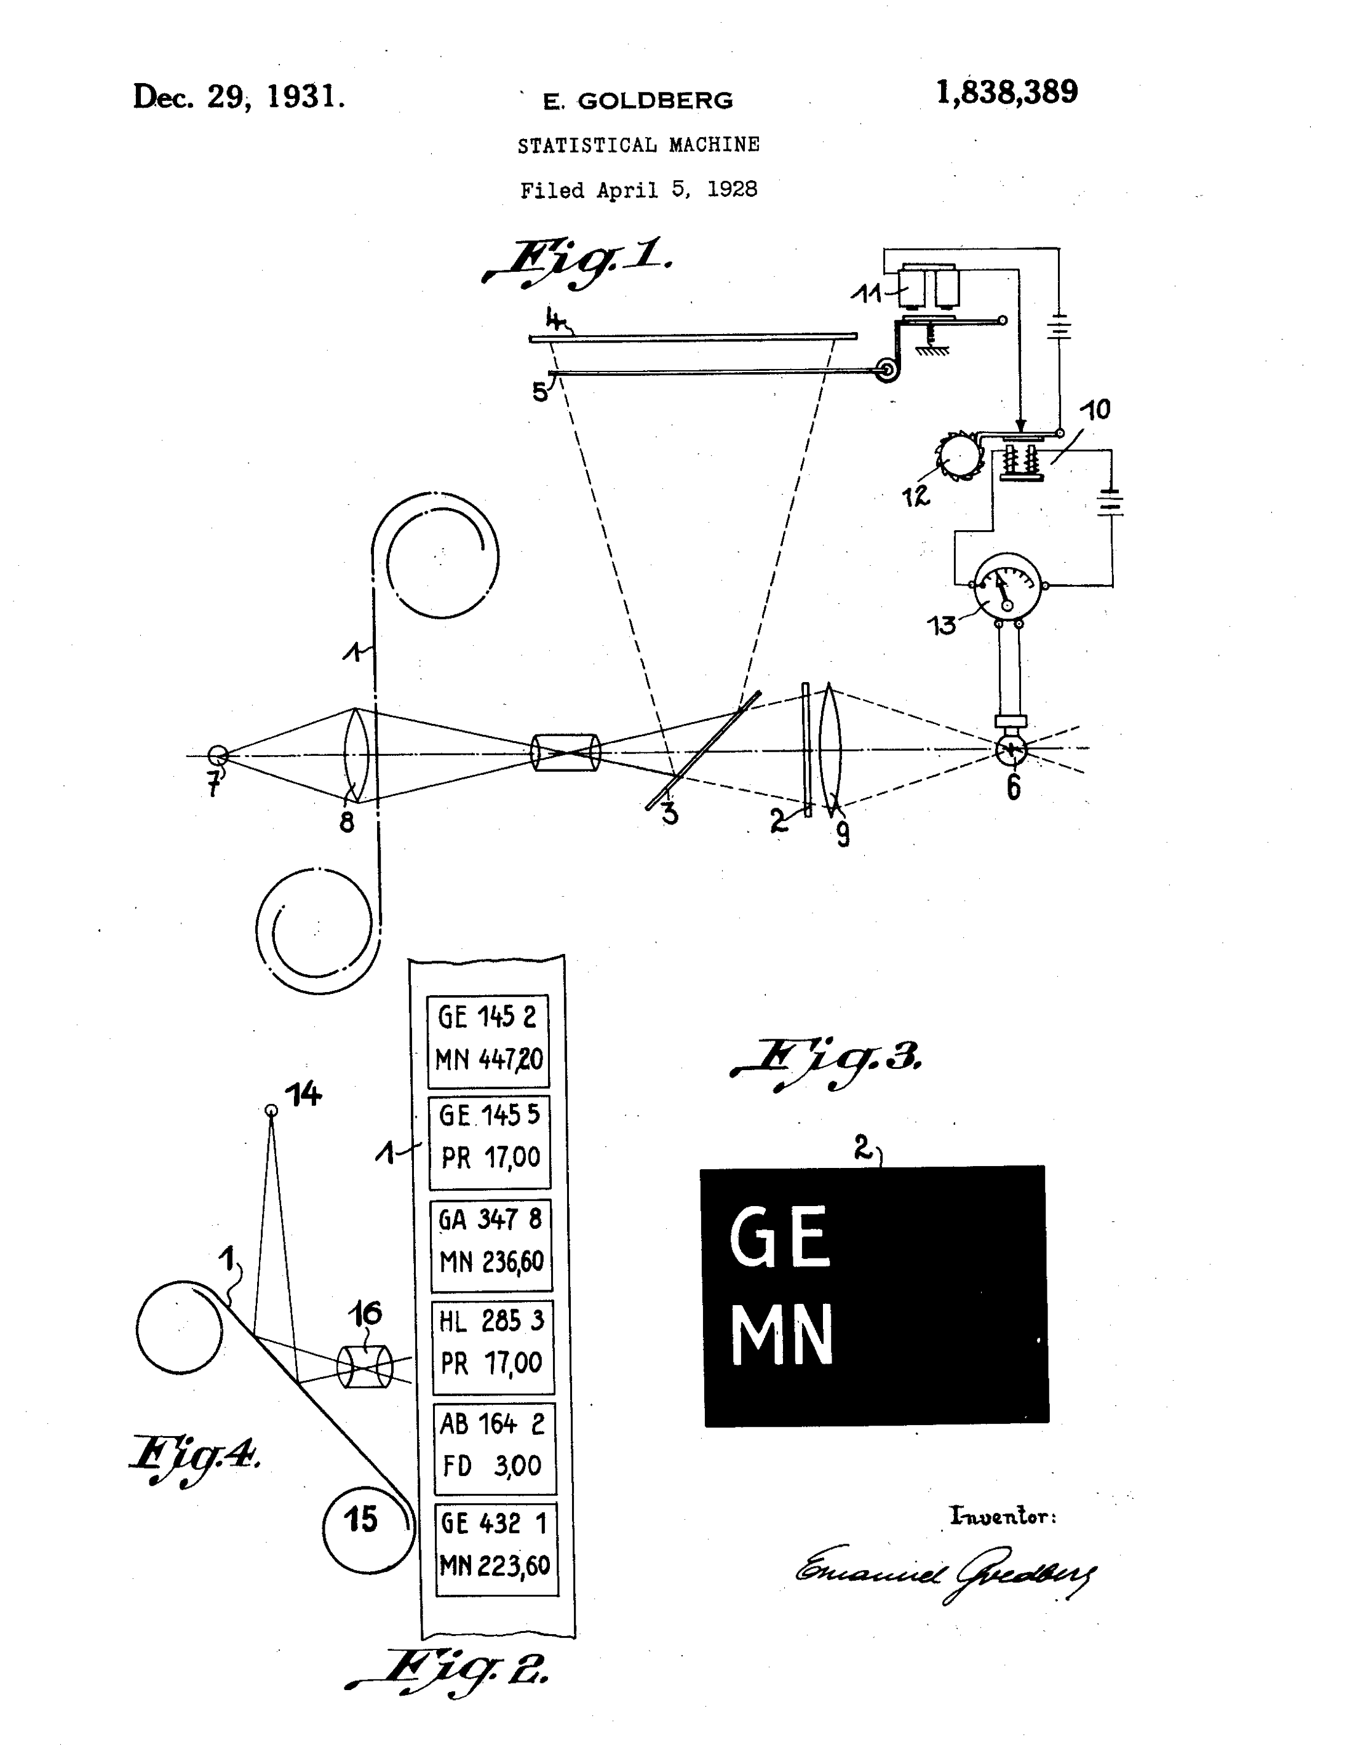

1920s – 1930s
Demonstration model built by HAW Hamburg students:
http://www.searchstudies.org/tl_files/ADSDS/Projektbericht_Statistische_Maschine_Gurevich_Heuer_Turkiewicz.pdf
Patent info: http://patft.uspto.gov patent 1 838 389
Notes:
1928 All information in your vest pocket
You need a search engine!
Codes with microfilm images, matched optically to select subset (e.g. Exports to country GE of Model MN)
Some 70 years before Google (1998)
---
Presented at 8th International Congress for Photography, Dresden, August 1931
Patented applied in USA 1928, rewarded in 1931.
Promptly bought by IBM
Pre-Vannevar Bush’s Memex
Some 70 years before Google (1998)
Kidnapped by Nazis from Zeiss in 1933, then left Germany for Tel Aviv
Zeiss did not develop it further

Slide 13
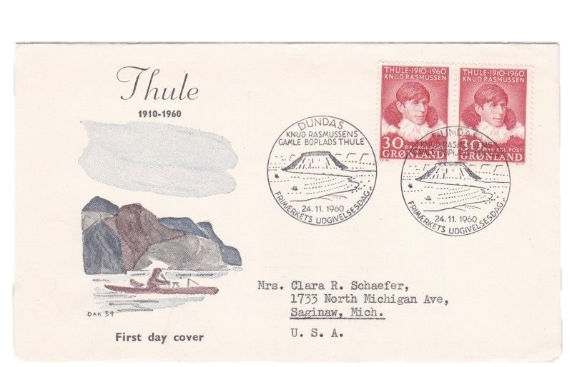
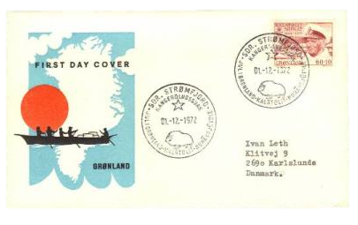
1960s
Notes:
1960s saw the introduction of postal codes to make sorting more efficient
USA – zip codes 1963
1965 – first automated OCR sorter (USA)
Denmark 1967
Norway – postal codes since 1968
Mail sorting – OCR automation by 1980s
https://en.wikipedia.org/wiki/ZIP_code
http://www.denstoredanske.dk/It,_teknik_og_naturvidenskab/Elektronik,_teletrafik_og_kommunikation/Postforsendelser/postnummer?highlight=postnummer
http://snl.no/postnummer

Slide 14
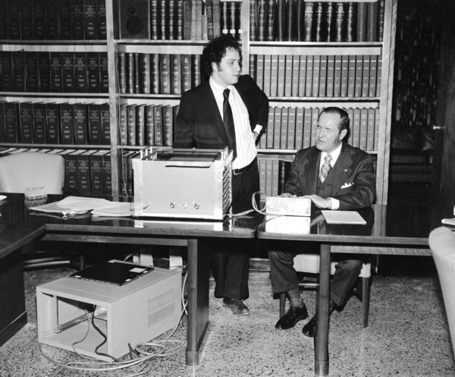
1970s
Kurzweil Reading Machine
(1976)
64 KB RAM
¼ MHz CPU
Flatbed CCD Scanner
Software:
Omnifont OCR
Text-to-speech
Price in today’s money:
195,900 USD (2014 at CPI infl.)
1.16 million NOK
January 1977 – Kurzweil unveils the Reading Machine at Iowa Commission for the Blind
http://www.iowablindhistory.org/blindhistory/tools-and-technology-optical-character-recognition-scanners
Notes:
Commercial 1977: USD 50 000 per machine ($195,900 in today’s USD based on CPI inflation = 1.16 million NOK)
Some 60 years after Fournier d’Albe, up from 25 to 200 words per minute
--
CCD Scanner – 64 kB RAM only so had to OCR page in strips, on-the-fly

Slide 15
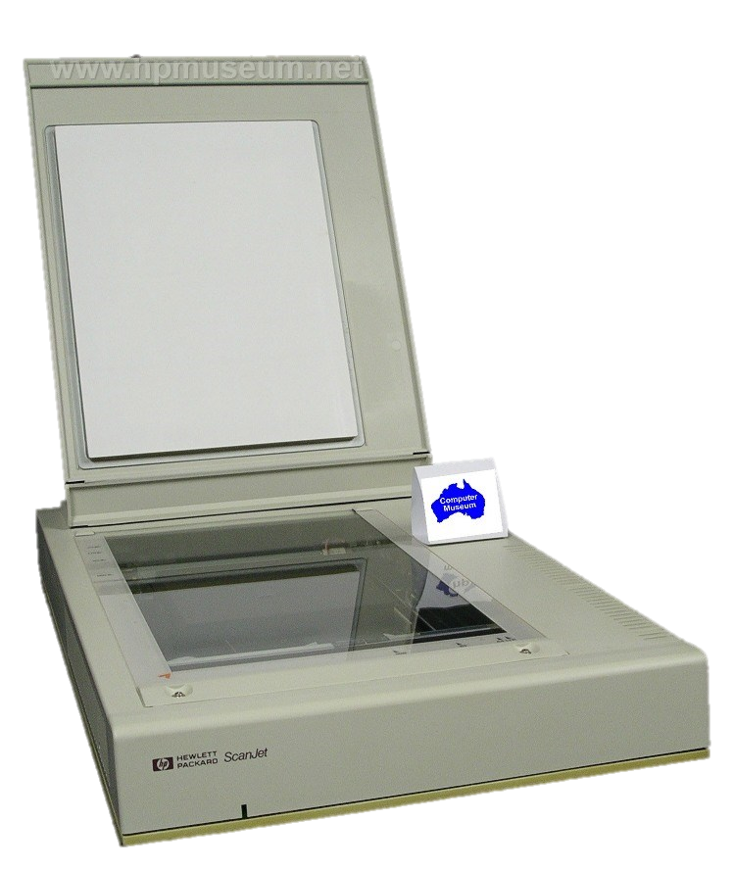
1980s
1987 - HP introduces the desktop scanner, ScanJet
http://www.hpmuseum.net/display_item.php?hw=295
Notes:
1987 OCR starts to go mainstream

Slide 16
Optical Character Recognition
OCR
Notes:
We are used to dealing with numbers and text strings, not images
Let’s look at how to read text in Images

Slide 17
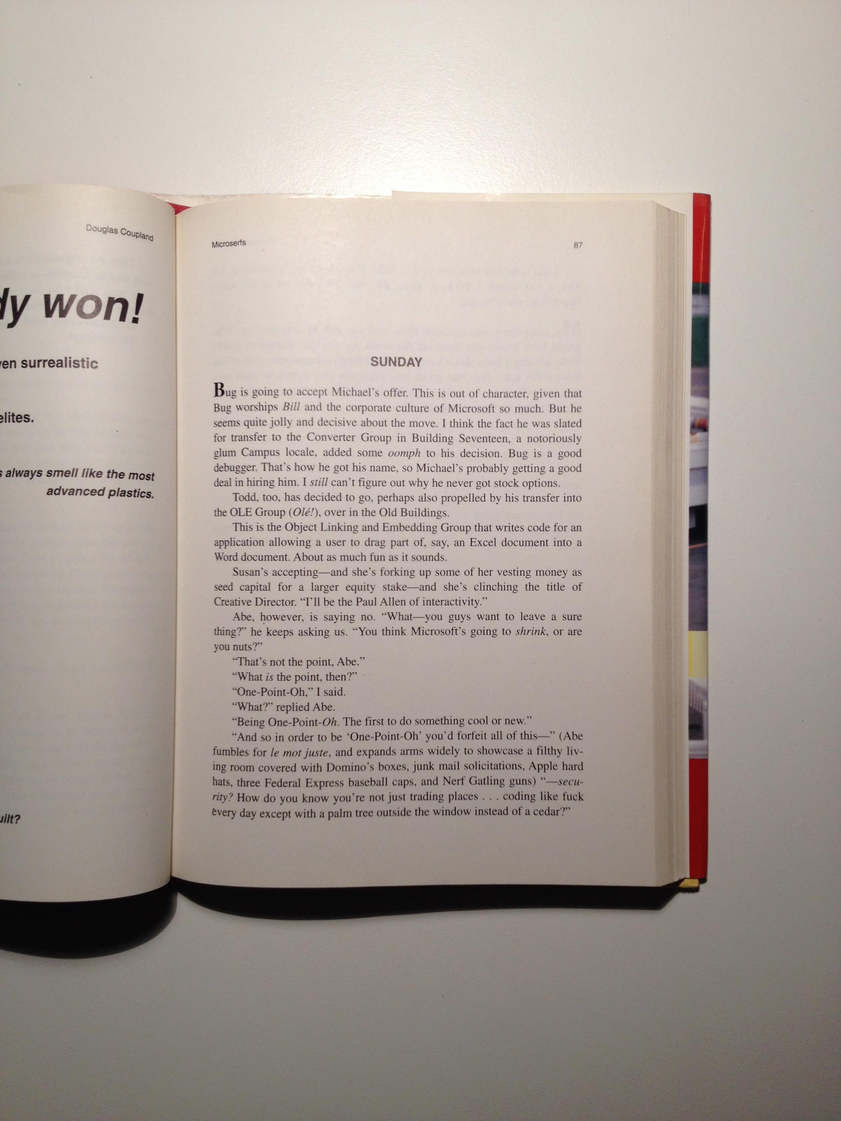
Reading Text From Images
SUNDAY
Bug is going to accept Michael’s offer.
Illustration: Douglas Coupland, “Microserfs”,Harper Collins, New York, NY, USA, 1995
Notes:
The basic problem is this…
There are a number of complexities to deal with

Slide 18
Where is the Page?
Notes:
Find the edges of a large +/- rectangular area
Preprocessing:
Generally called “layout analysis” (columns, page numbers, book title etc.)

Slide 19
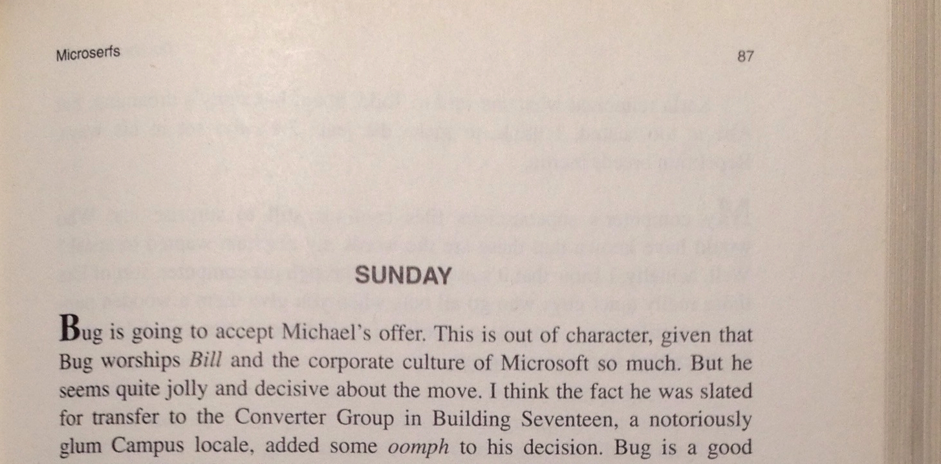
Multiple Texts and Fonts
Notes:
Layout Analysis elements
Book Title top right
Page Number top left
Headline
Main text
Fonts
Text, with “raised initial”
Notice also italics Bill

Slide 20
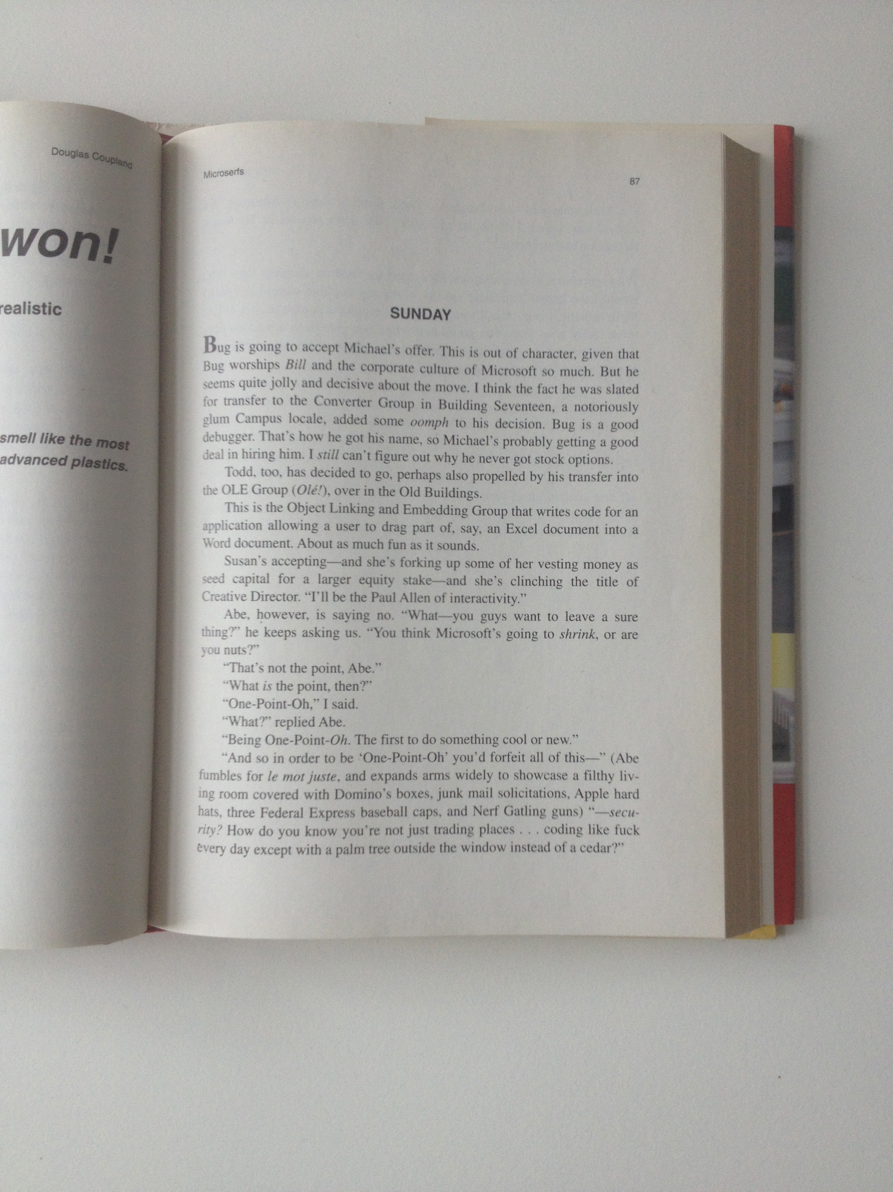
White Isn’t
Notes:
Notice the white balance
The gradients across the page
“White” is defined locally only

Slide 21
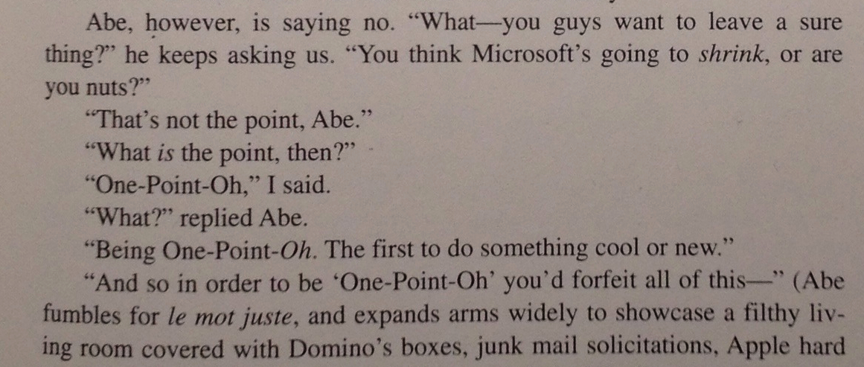
Straight Lines Aren’t
Notes:
Geometry is also not straightforward
Etc. etc.

Slide 22
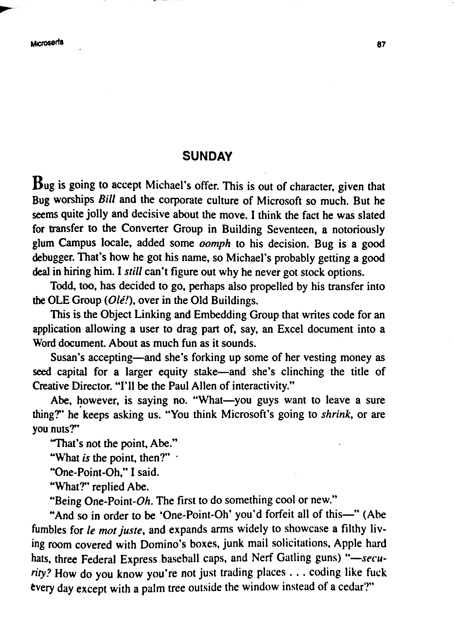
OCR Pipeline
Acquisition
Preprocessing
Text output
Magic
“That’s not the point, Abe.”
“What is the point, then?”
“One-Point-Oh,” I said.
“What?” replied Abe.
“Being One-Point-Oh. The first to do something cool or new.”
Notes:
So OCR is two stages
Preprocessing – layout analysis
Let’s see how to do it

Slide 23


OpenCV – Computer Vision Library
2500 CV Algorithms
BSD license
All main platforms
CUDA, OpenCL acceleration
Realtime, multi-core
http://opencv.org
Notes:
OpenCV
Think of it as an Army of PhD’s in a box
---
OpenCV code – free open-source, from Intel Research Russia (1999) to use more CPU

Slide 24
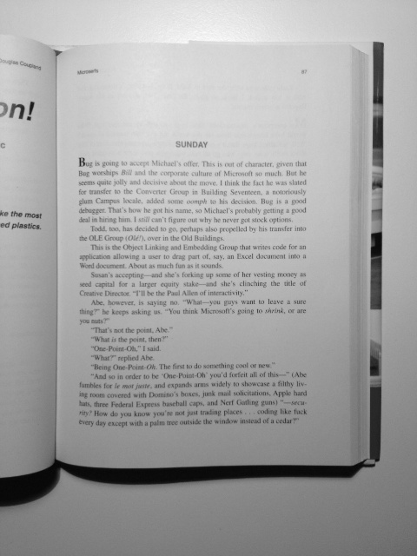
Where is the Page? Trick 1: Reduce Size and Colours
def find_page_with_canny(img):
'''Find the page in the image.'''
gray = cv2.cvtColor(img, cv2.COLOR_BGR2GRAY)
show('1: Input image', gray)
Example code: src/books.py
Notes:
Python code
For speed and simplicity – reduce size, reduce to grayscale
Gaussian Blur 3, 480x640

Slide 25

Where is the Page? Trick 2: Remove Noise and Details
def find_page_with_canny(img):
'''Find the page in the image.'''
gray = cv2.cvtColor(img, cv2.COLOR_BGR2GRAY)
show('1: Input image', gray)
# Remove high-frequency noise (e.g. letters)
median = cv2.medianBlur(gray, 7)
show('2: Median filtered', median)
Example code: src/books.py
Notes:
We are not interested in “details”, so we filter (blur)
Again, reduce complexity where possible – for speed and simplicity

Slide 26
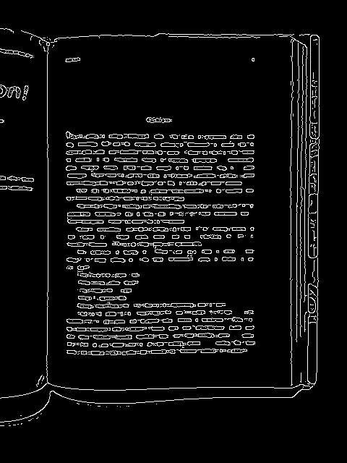
Trick 3: Find Edges
def find_page_with_canny(img):
'''Find the page in the image.'''
gray = cv2.cvtColor(img, cv2.COLOR_BGR2GRAY)
show('1: Input image', gray)
# Remove high-frequency noise (e.g. letters)
median = cv2.medianBlur(gray, 7)
show('2: Median filtered', median)
edges = cv2.Canny(median, 10, 20,
apertureSize=3)
show('3: Edges', edges)
Example code: src/books.py
Notes:
Canny detects variations in the gradient of the image
Gradient – up/down/left/right for each pixel
“large” change indicates edge,
for adjacent gradients in same direction, the largest one is “the” edge
10,20 – two threshold params
Notice the details are gone
Notice “holes” in edge

Slide 27
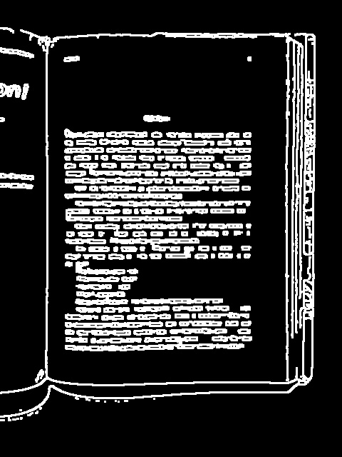
Trick 4: Dilate to Thicken
def find_page_with_canny(img):
'''Find the page in the image.'''
gray = cv2.cvtColor(img, cv2.COLOR_BGR2GRAY)
show('1: Input image', gray)
# Remove high-frequency noise (e.g. letters)
median = cv2.medianBlur(gray, 7)
show('2: Median filtered', median)
edges = cv2.Canny(median, 10, 20, apertureSize=3)
show('3: Edges', edges)
dilated = cv2.dilate(edges,
kernel=None,
iterations=1)
show('4: Dilated Edges', dilated)
Example code: src/books.py
Notes:
Dilate closes “holes” in edges and thickens them
Erode is often used after – makes edges thinner

Slide 28
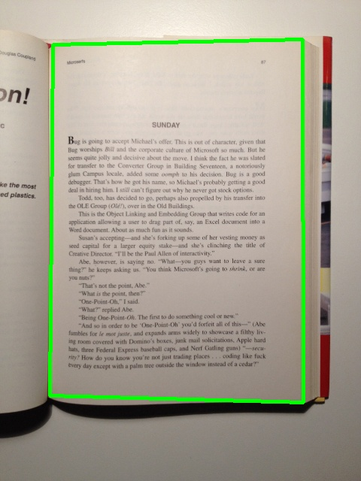
Trick 5: Find Contours
def find_page_with_canny(img):
'''Find the page in the image.'''
gray = cv2.cvtColor(img, cv2.COLOR_BGR2GRAY)
show('1: Input image', gray)
# Remove high-frequency noise (e.g. letters)
median = cv2.medianBlur(gray, 7)
show('2: Median filtered', median)
edges = cv2.Canny(median, 10, 20, apertureSize=3)
show('3: Edges', edges)
dilated = cv2.dilate(edges, kernel=None, iterations=1)
show('4: Dilated Edges', dilated)
min_page_area = img.shape[0] * img.shape[1] / 4
quads = find_quadrilaterals(dilated, min_area=min_page_area, cos_epsilon=.8)
quads_found = draw_contours(img, quads)
show('5: Page found', quads_found)
def find_quadrilaterals(img, min_area, cos_epsilon):
quads = []
contours, hierarchy = cv2.findContours(img.copy(), cv2.RETR_LIST, cv2.CHAIN_APPROX_SIMPLE)
for cnt in contours:
cnt_len = cv2.arcLength(cnt, True)
poly = cv2.approxPolyDP(cnt, 0.02*cnt_len, True)
if len(poly) == 4 and cv2.contourArea(poly) > min_area and cv2.isContourConvex(poly):
Example code: src/books.py
Notes:
.shape is the width and height
Anim 1: find_quadrilaterals function
findContours : a contour is a vector of points
approxPolyDP : img, epsilon, closed?
DP = distance/precision (max error)

Slide 29
Where is the Page?
def find_page_with_canny(img):
'''Find the page in the image.'''
gray = cv2.cvtColor(img, cv2.COLOR_BGR2GRAY)
median = cv2.medianBlur(gray, 7)
edges = cv2.Canny(median, 10, 20, apertureSize=3)
dilated = cv2.dilate(edges, kernel=None, iterations=1)
min_page_area = img.shape[0] * img.shape[1] / 4
quads = find_quadrilaterals(dilated, min_area=min_page_area, cos_epsilon=.8)
quads_found = draw_contours(img, quads)
Example code: src/books.py
Notes:
What we have seen:
Typical image preprocessing pipeline
No PhD required
Find the page, including helper functions - less than 100 lines of code
Better than many whiteboard photo apps!

Slide 30
OCR Pipeline
✔
Acquisition
Preprocessing
Text output
Magic
“That’s not the point, Abe.”
“What is the point, then?”
“One-Point-Oh,” I said.
“What?” replied Abe.
“Being One-Point-Oh. The first to do something cool or new.”
Notes:
Let’s come back to the OCR itself
“the magic part”

Slide 31
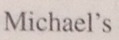
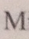
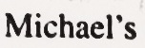
Magic Explained
Adaptive Filter to Black/White
Component shape extraction
Character / font
Training data
Shape matching
M
i
c
h
a
e
l
’
s
Probabilities
l
e
c
Language
Training data –
Dictionaries etc.
Word matching
lang=ENG
Michael’s
Statistical
confidence
Notes:
Typical system
Hierarchical model
Pixels - Shapes – letters - words
Shape extraction and matching
Trainable
E.g. CAPTCHA – used as training data

Slide 32
OCR Shape Matching
Layer 1 - Primitives
Layer 2 - Letters
Match
M
Match
No match
E
No match
(w * h) pixels * bit-depth
Feature vector
char
Notes:
Hierarchical feature recognition
Notice again how it’s like compression
(image dims / 20*20*8 bits = 3200 bits)
Feature vector ~50 bits (or 50 probabilities)
Char (8-16 bits)
With “deep learning” this can be learned in a Deep Belief network (typically a Restricted Boltzmann Machine)
Often deep learning (multi-layer neural network, Restricted Boltzmann Machine)
Layer 1: “features” strokes (vertical stroke, slanted from up to down, …”
Visual Vocabulary (parts, symbols, syntax (not semantics and pragmatics))
“Deep learning” – more layers, e.g. language n-grams, … (Hinton et al., can train layer by layer, about 10 years ago)
The same technique used to
- Face recognition…
- analyse “City Characteristics” in Street View images (e.g. balcony on 1st, 2nd or 3rd floor)

Slide 33
Tesseract OCR Library
Free, open-source software
Developed by HP Labs 1985-1995
Now sponsored by Google
C++
Windows, Mac, Linux, Android, iOS
Wrappers for .NET, Python, …
Apache License 2.0
http://code.google.com/p/tesseract-ocr/
1987 - HP introduces the desktop scanner, ScanJet
http://www.hpmuseum.net/display_item.php?hw=295
Notes:
This sounds complicated, luckily there is a library for that
It runs on your phone, too!
---
Ray Smith of Google says it was never used in an HP product! (OSCON 2007)
Google scanned “all the world’s books” – like Goldberg’s 1920s vision

Slide 34
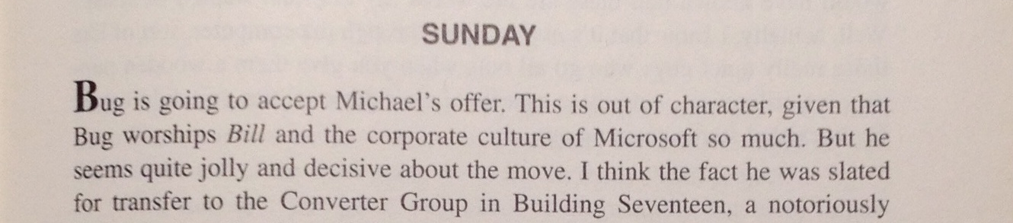
OCR - Magic Happens Here
def ocr_text(img):
'''Perform OCR on the image.'''
tr = Tesseract(lang='eng’)
pil_image = pil.Image.fromarray(img)
tr.set_image(pil_image)
utf8_text = tr.get_text()
return utf8_text
SUNDAY
Bug is going to accept Michael‘s offer. This is out of character, given that
Bug worships Bill and the corporate culture of Microsoft so much. But he
seems quite jolly and decisive about the move. I think the fact he was slated
for transfer to the Converter Group in Building Seventeen, a notoriously
Example code: src/books.py
Notes:
Really simple
Really powerful
Runs on your phone!
Know you know how to do a state of the art document scanner for your phone.
Think about where you can use it,
sometimes even if OCR is not perfect (indexing/search - Evernote)
“computer assisted” workflows

Slide 35
Cars
Application: Feature Extraction
Notes:
Let’s see how we can use this
To solve a 22 M kr problem in a few hundred lines of code

Slide 36
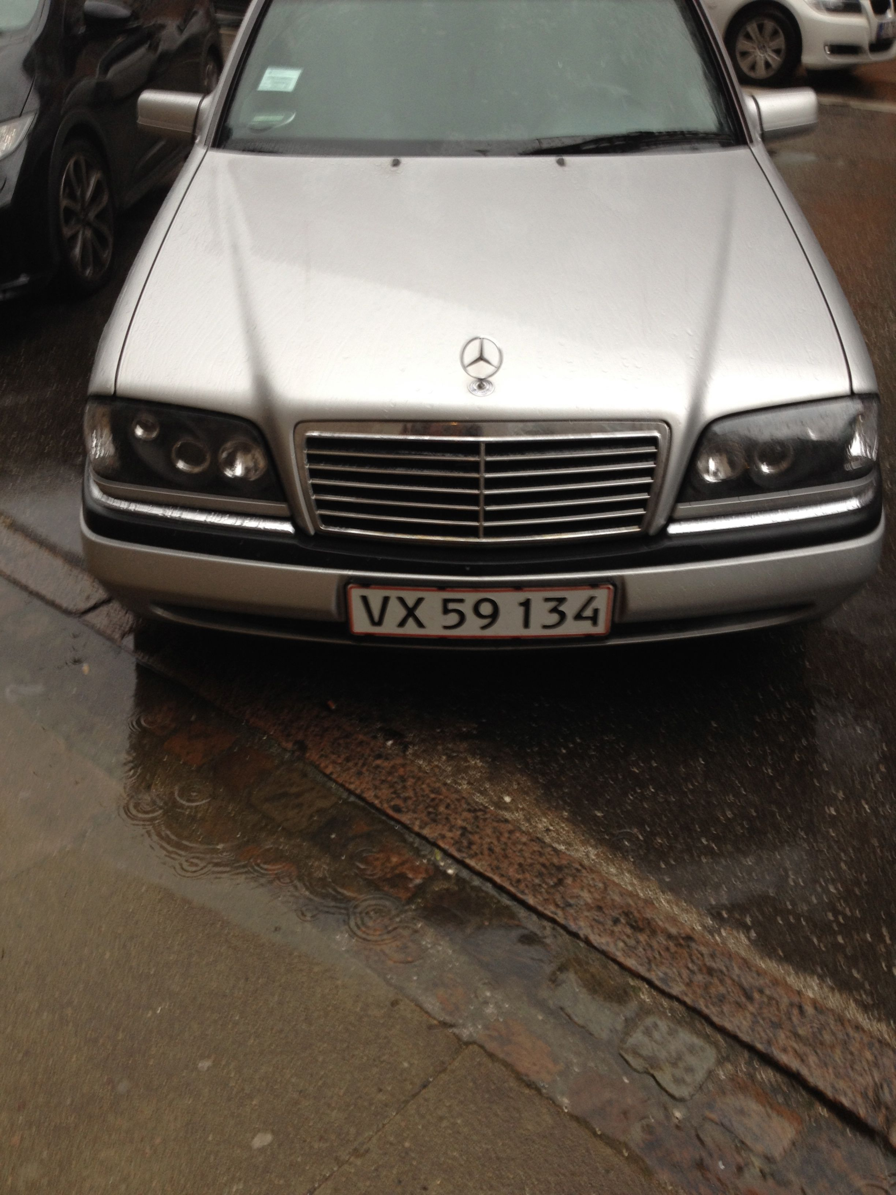
Pipeline
Find Plate
Read Plate
Danish Police (2013)
400,000 “wanted” plates in Denmark
Automatic scanning and lookup from police cars
Vision pilot project: 20 million DKK (22 M NOK)
(Norway already has this)
VX 59 134
Look up plate
Notes:
You can see the Police put a price tag on the value of this
After this lecture, you can build it yourself
The police system wants to stream the video over their mobile network to a server.
Let’s see how we can do this on-board with a 500 kr Raspberry Pi

Slide 37
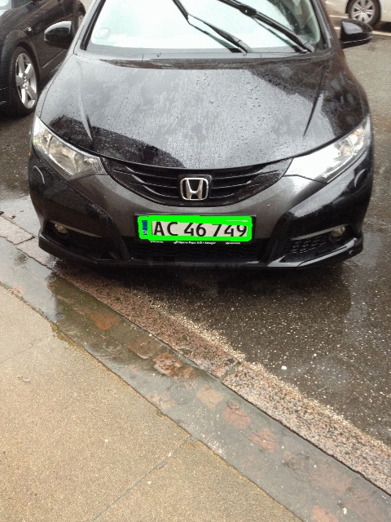
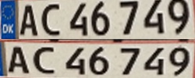
Find the Plate
Find rectangles in multiple representations
Find edges at various grayscale levels (threshold to B/W)
Detect edges, extract rectangles as before
Plates have (approximately) 5:1 proportions
Two candidate plate regions found
Example code: src/cars.py
Notes:
A bit more complex than books on cars “in the wild”
We will use a simple approach
And more CPU

Slide 38
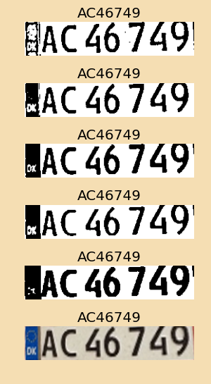
Read the Plate
Transform perspective to “head on”
Filter plate to different representations
Adaptive threshold
Manually threshold at middle gray
Black/white with optimal threshold (“OTSU”)
Erode/dilate letters
OCR all
Match OCR texts to “2 letters, 5 digits”
Select most frequently matched
Example code: src/cars.py
Notes:
Overkill strategy

Slide 39
Plate Filtering
def match_plates(title, candidate_plate_images):
'''Returns a list of the possible matches for the plate.'''
matches = []
n = 0
for cp in candidate_plate_images:
# Filter to different representations
n = n+1
gray = cv2.cvtColor(cp, cv2.COLOR_BGR2GRAY)
adaptive = cv2.adaptiveThreshold(gray, 255, cv2.ADAPTIVE_THRESH_MEAN_C,
cv2.THRESH_BINARY, 11, 15)
ret_val, th = cv2.threshold(gray, 100, 255, cv2.THRESH_BINARY)
t_otsu, th_otsu = cv2.threshold(gray, 100, 255, cv2.THRESH_BINARY + cv2.THRESH_OTSU)
ret_val, th_otsu = cv2.threshold(gray, t_otsu, 255, cv2.THRESH_BINARY)
# thin the black parts (letters and noise)
dilated = cv2.dilate(th_otsu, kernel=(5,5), iterations=2)
# thicken the letters
eroded = cv2.erode(dilated, None)
image_variants = [cp, adaptive, th, th_otsu, dilated, eroded]
image_matches = [m for m in map(ocr_plate, image_variants)]
if PLOT_MATCHES:
plot_image_variants_and_matches("%s matches %d" % (title, n),
image_variants, image_matches)
matches += [m for m in image_matches if m]
return matches
Example code: src/cars.py
Notes:
Here you see the same thing in
Very simple code

Slide 40
OCR Code
# ----------------------------------------------------------------
# Text recognition
# ----------------------------------------------------------------
def ocr_text(img):
tr = Tesseract(lang='eng')
tr.clear()
pil_image = pil.Image.fromarray(img)
# Turn off OCR word dictionaries
tr.set_variable('load_system_dawg', "F")
tr.set_variable('load_freq_dawg', "F")
tr.set_variable('-psm', "7") # treat image as single line
tr.set_variable('tessedit_char_whitelist', "ABCDEFGHIJKLMNOPQRSTUVWXYZ0123456789")
tr.set_image(pil_image)
utf8_text = tr.get_text()
return unicode(utf8_text)
def ocr_plate(img):
text = ocr_text(img)
match = re.search(r"[A-Z][A-Z] *\d{2} *\d{3}", text)
result = None
if match:
result = match.group()
# Canonicalize to no spacing
result = result.replace(' ', '’)
return result
Example code: src/cars.py
Notes:
All in all a few hundred lines of code
But apparently worth more than 20 mill NOK!

Slide 41
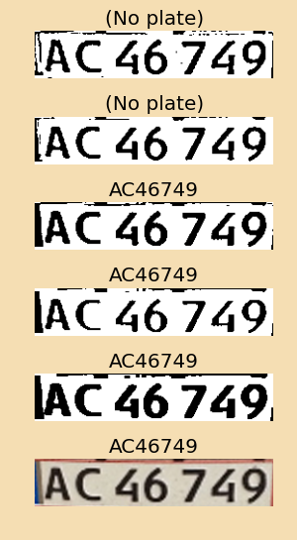
Number Plate Recognition
Example code: src/cars.py
Notes:
Here the image is very clean
All versions OCR well

Slide 42
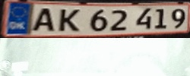
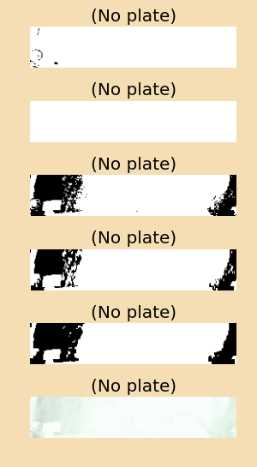
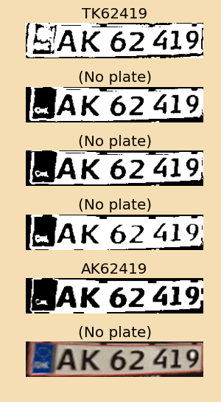
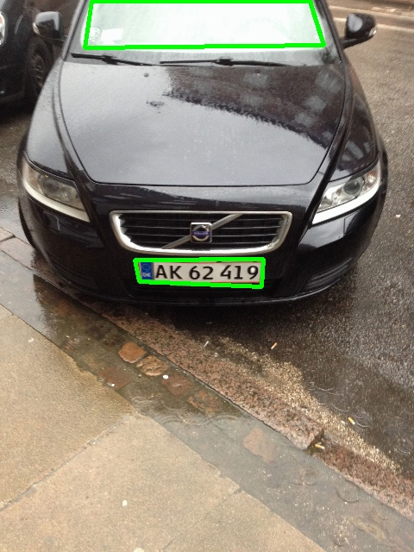
Number Plate Recognition
Example code: src/cars.py
Notes:
Here you see why multiple representations are useful
Windscreen has same proportions
Notice how “noise” throws off the OCR
“No plate” means it cannot fully match according to the regex
Of course, it has its limits… (next slide)

Slide 43
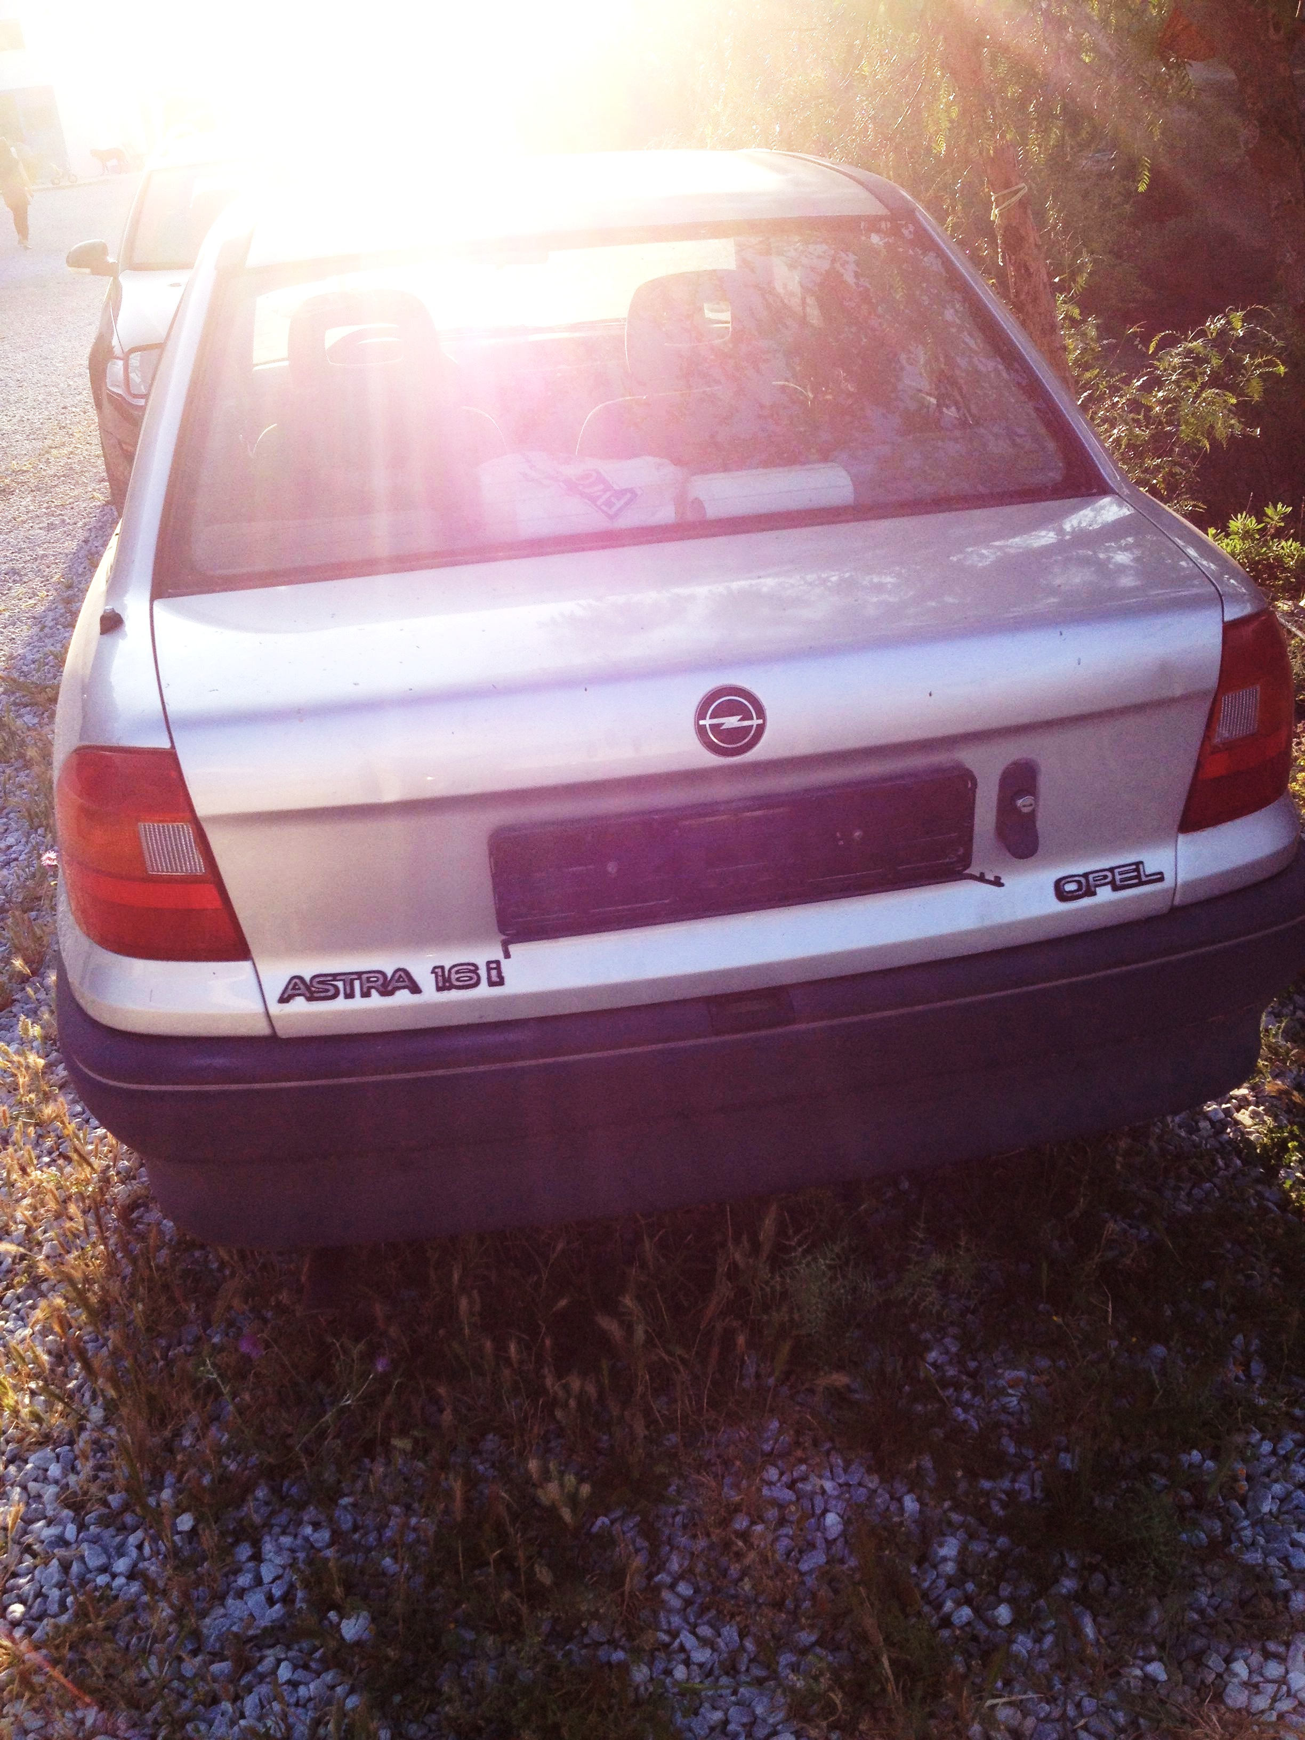
#FAIL
Notes:
Pretty good for a simple solution
And remember, you have 20 mill. to improve it

Slide 44
Pizza
Feature Recognition
Notes:
That was cars
Now it’s time for pizza

Slide 45
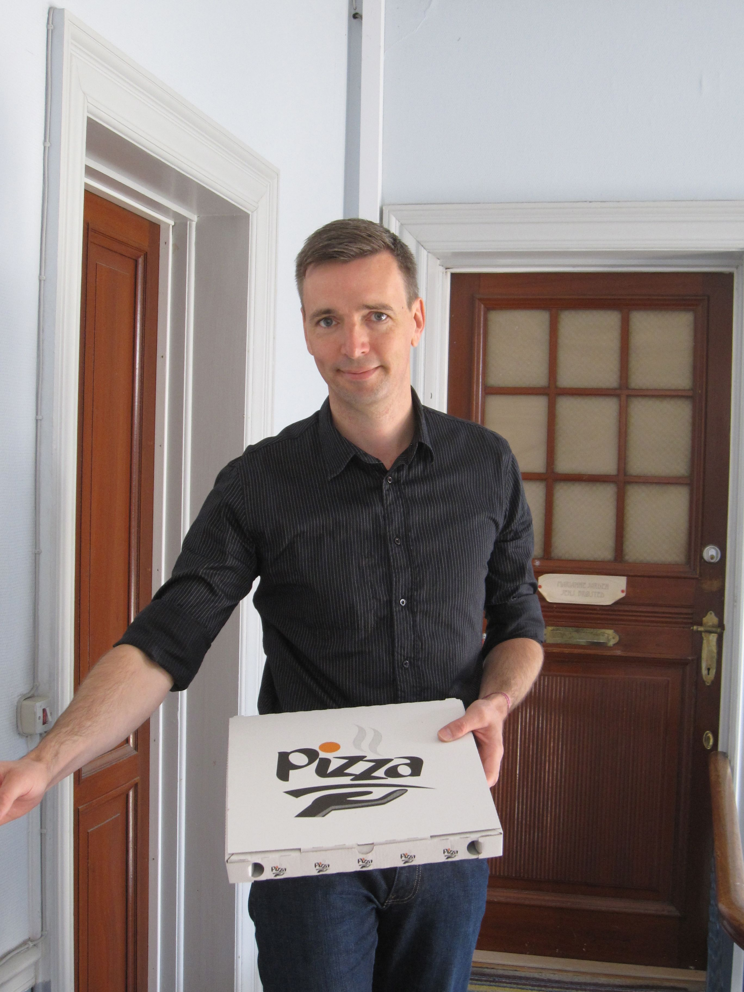
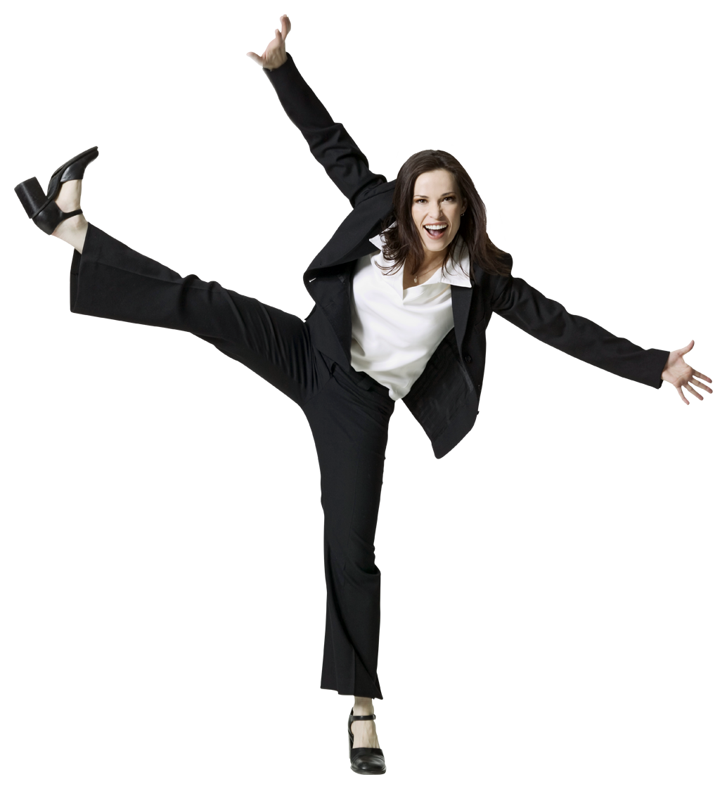
How would you do it?
Pizza time!
Notes:
I always wanted a pizza alarm
Something we all need in our entrance

Slide 46
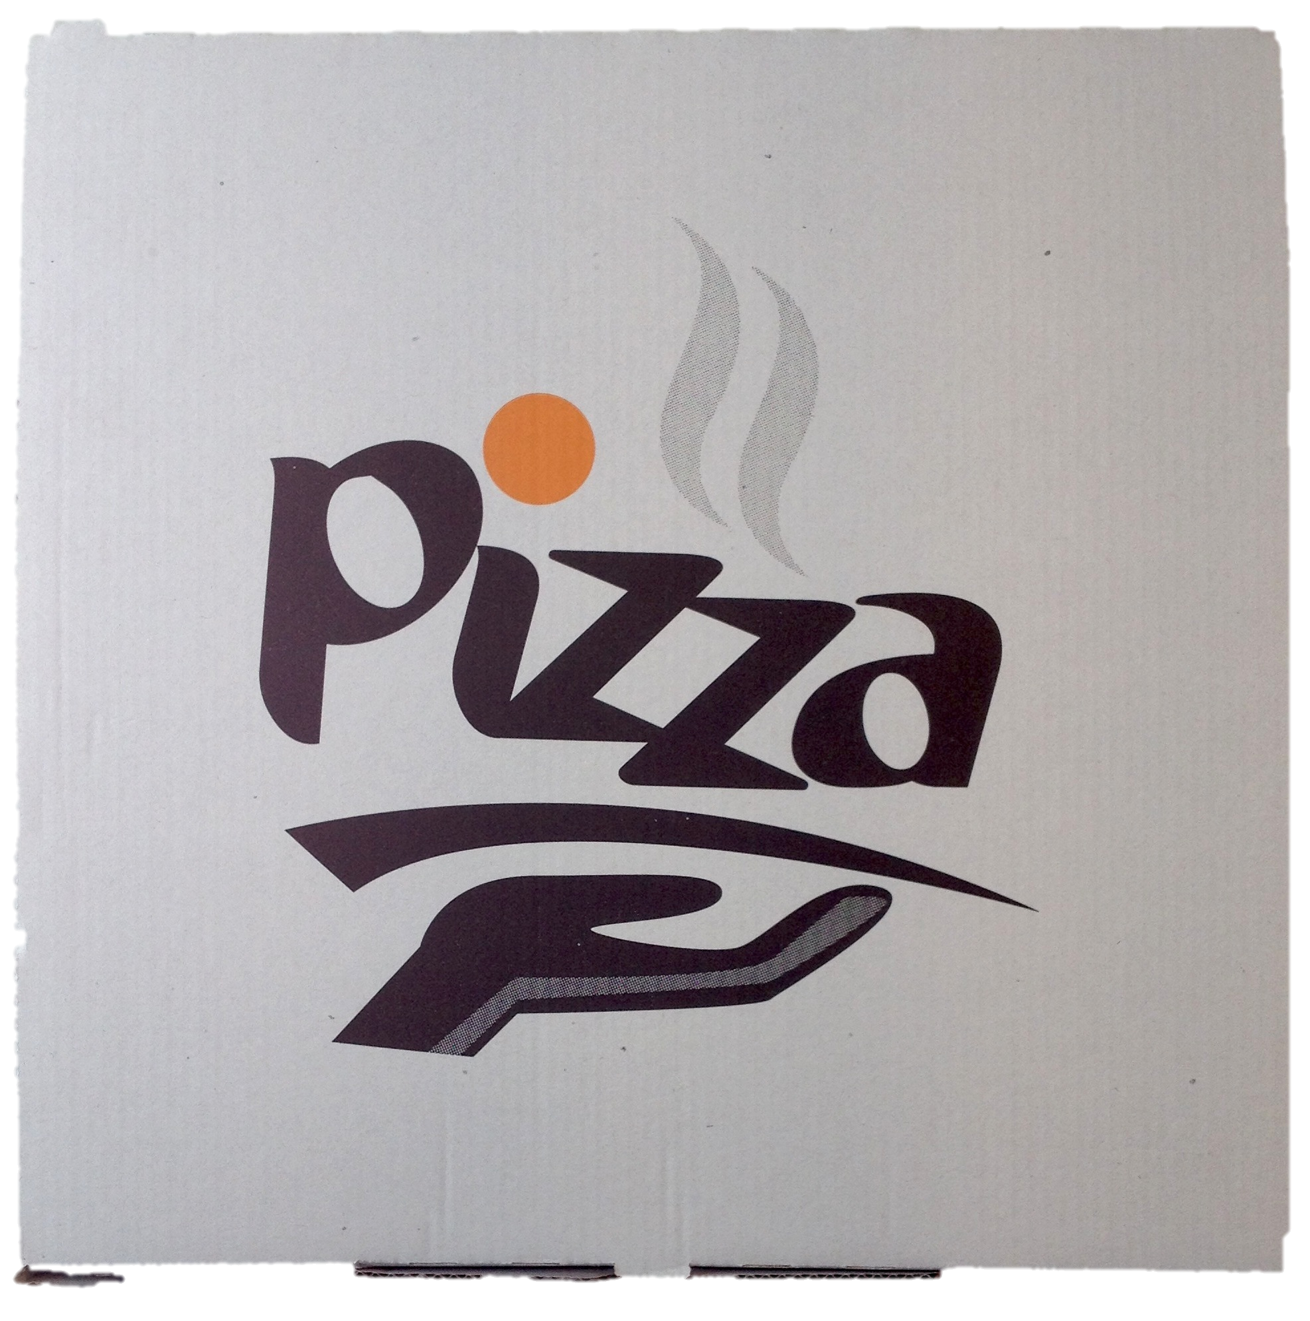
20 Questions…
Quadrilateral found?
Is it dominantly white?
Percentage of surface
Black
Orange
Grey
Skin tones on edge of quad?
Is there a face shape?
Is face above and near quad?
…
➔ Probably a pizza box
Notes:
Requires a lot of coding
Alternatively, this is a description of an ensemble of weak classifiers (Machine Learning)

Slide 47
1920s Revisited
1920s
Template
matching
Layer 1 - primitives
Layer 2 - letters
M
OCR
Shape
Matching
Notes:
Emanuel Goldberg
Search via “search cards” with template to match.
We can do the same here

Slide 48
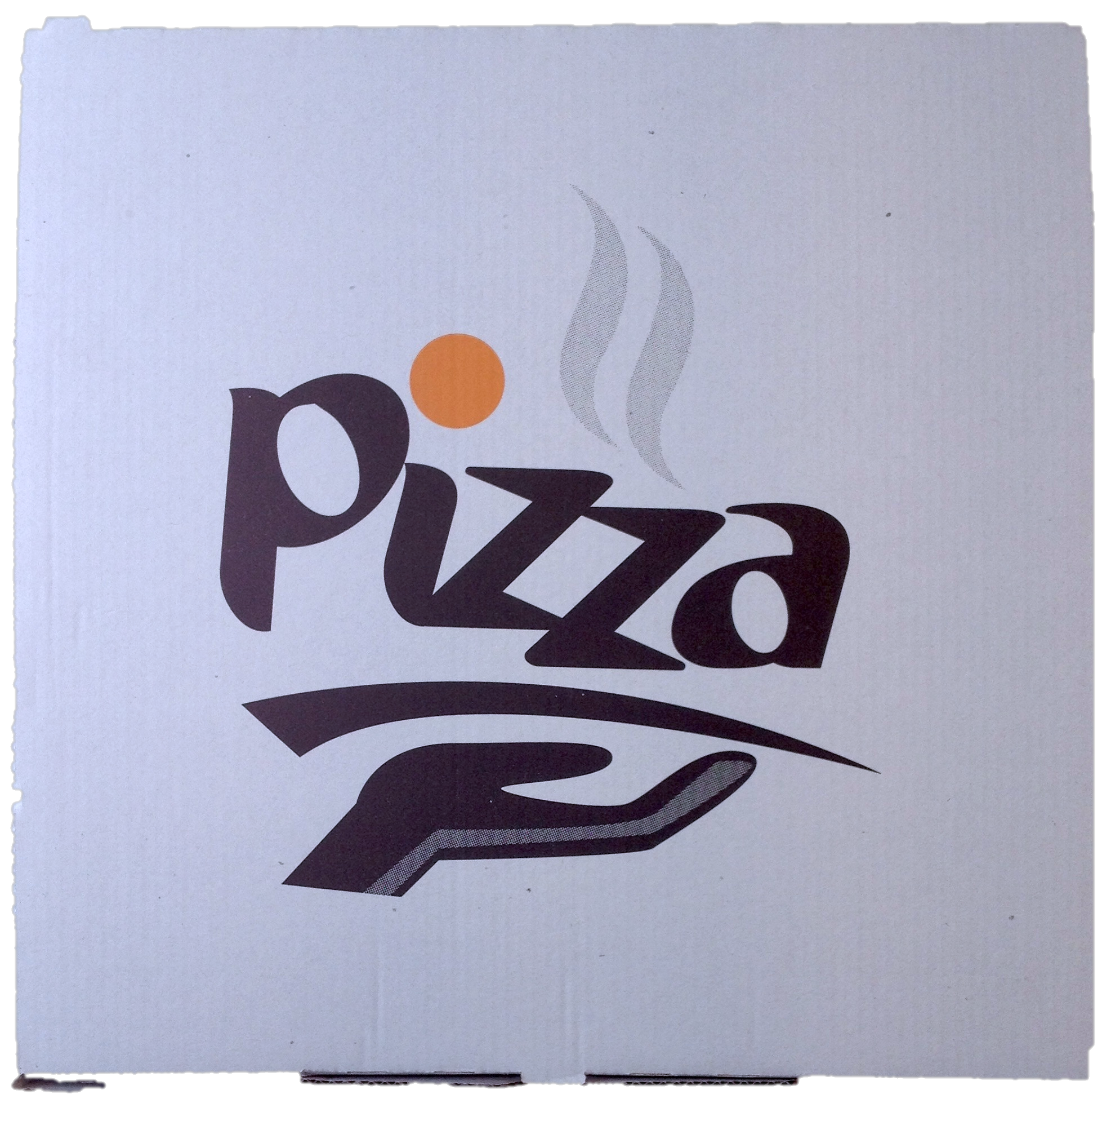
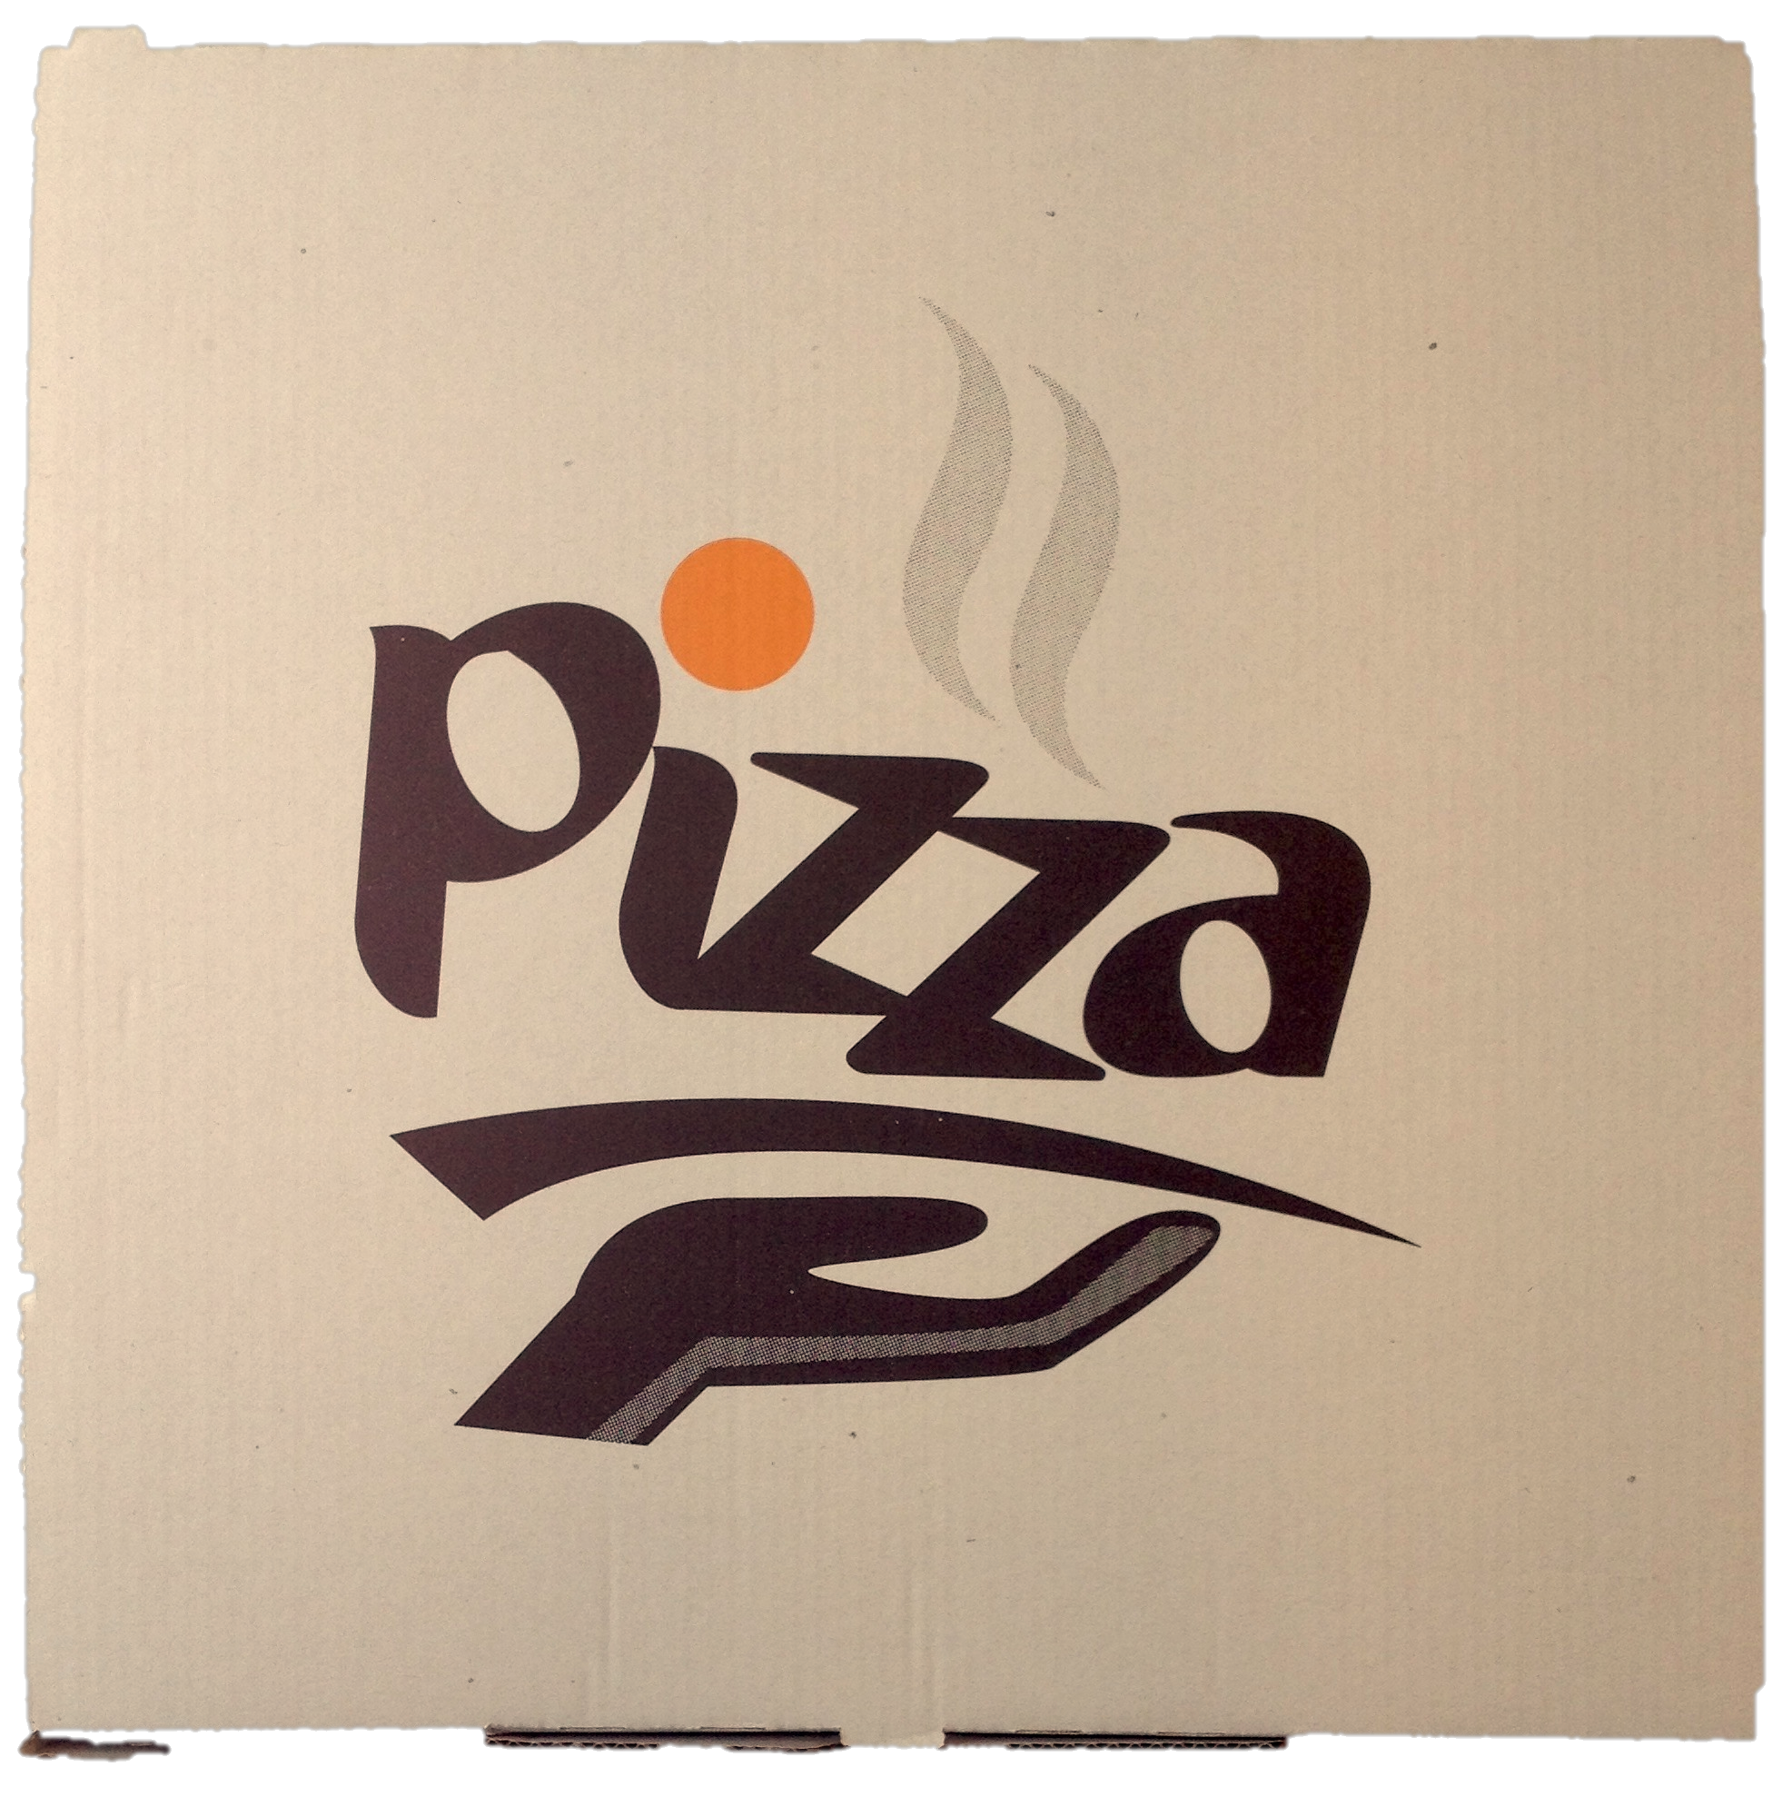
Known Object Detection
Position
Scale
Brightness /
illumination
Orientation
Notes:
Task: Match against known pizza box image
Complexities

Slide 49

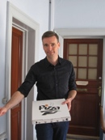

Scale: Pyramid or Scale-Space
Pixels, e.g.
½ M
2 M
8 M
“Cheap” to repeat at various scales
Half size = ¼ pixels
Notes:
More modern systems use a process called scale-space (scale factor with blurring)
Pyramid is easy to understand
Fast, as half-size image is ¼ pixels
E.g. “Page finding” – we blurred-down to 480x640 and analysed at that res.
Lower resolution – faster and less (irrelevant) details for many problems

Slide 50
HOG – Histogram of Oriented Gradients
Weight
•
Upper left corner “signature”
⬆
•
•
•
•
⬆
⬆
⬆
⬆
⬅
•
•
⬅


⬆
⬆
⬆

•
•
⬅


⬆
⬆
⬆
•
•
⬅
⬅
⬅
•
•
•

➔

⬇

Orientation
•
•
⬅
⬅
⬅
•
•
•
Notes:
Same idea as Canny edge detection
Compare cells to left and right (gradient) (-1,0,1), (-1,0,1)^{T}
Histogram – distribution of non-edges and directed edges
Local, tile image into many cells
Compare to get scale-invariant likeness measure
Not rotation invariant
Really good for e.g. person detection

Slide 51
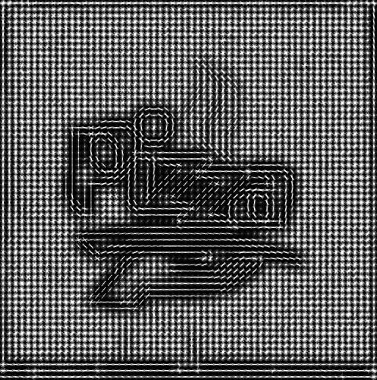
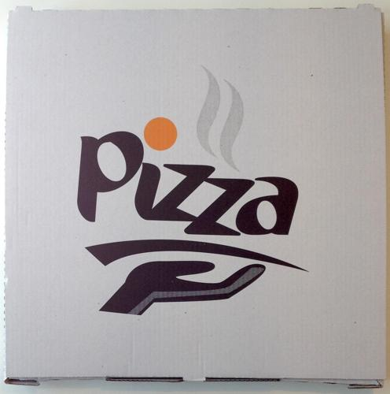
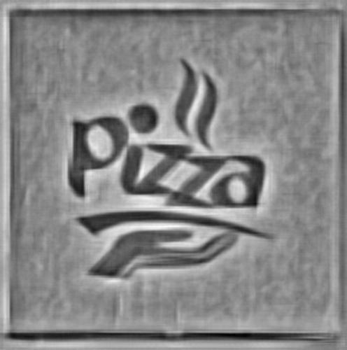
HOG Example
Input
HOG
HOG reverse
Images generated with HOG visualizer at http://web.mit.edu/vondrick/ihog/index.html
Notes:
Neat visualization
Tile image into cells, compute HOG per cell
HOG transform and detail
Notice the reveerse– the “shape” of the image is preserved through the compression to-from HOG
Also notice that we can compress it further by only taking “interesting” keypoints (high contrast areas)
HOG is an example of a keypoint (feature) descriptor (representation)

Slide 52
Feature Recognition
e.g. HOG
Train
Reference image
Detect characteristic features and their geometry
Compact representation
measure
“similarity”
Feature
Detection
Feature Descriptors
Feature
Recognition
“Detect”
“Scene” image
Detect characteristic features and their geometry
Compact representation
Match features and geometry
Notes:
Similar to what we hand coded in the Page and APRN example
Feature detection – local abstractions – “corner”, “edge”,…
Generalized algorithm
Fuzzy ML matching, “nearest neighbour”
Alternative – train on positive and negative images, e.g. “Haar classifier”

Slide 53
Feature Detection and Recognition
Match keypoints
Estimate geomtrical transformation
Notes:
SIFT – Scale Invariant Feature Transform
SURF – Speeded Up Robust Features
Solid-body homography
Let’s look at some examples…

Slide 54




Features Detection - Keypoints
Object
Small keypoints only
All keypoints
Example code: src/pizza.py
Notes:
lots of points to consider…
(high-res logo)

Slide 55

Features Detection - Keypoints
Small keypoints only
Example code: src/pizza.py
Notes:
Image is about 8 mega-pixel => many keypoints
Foreground masked to reduce (not all keypoints)

Slide 56
Feature Recognition
Notes:
This matches that?
Keypoints

Slide 57
Pizza Code
detector, norm = cv2.SURF(), cv2.NORM_L2
bf_matcher = cv2.BFMatcher(norm)
# Detect features in the reference object
object_keypoints, object_descriptors = detector.detectAndCompute(object_image, None)
# Detect features in the scene and match
scene_keypoints, scene_descriptors = detector.detectAndCompute(scene_image, None)
raw_matches = matcher.knnMatch(object_descriptors, scene_descriptors, k=2)
p1, p2, kp_pairs = filter_matches(object_keypoints, scene_keypoints, raw_matches)
MIN_MATCH_COUNT = 10
if len(kp_pairs)>MIN_MATCH_COUNT:
H, status = cv2.findHomography(p1, p2, cv2.RANSAC, 5.0)
match_lines_image = draw_matches(object_image, scene_image, kp_pairs, status, H)
show('Match lines', match_lines_image)
Example code: src/pizza.py
Notes:
Again, your personal Army of PhDs is very powerful
Top– once per known object
Lower part – once per scene (frame)
None is the mask (we could compute a foreground mask –see example code)
O(n³)
(joke) As an exercise, write Spaghetti Code for spaghetti delivery recognition
How does it fare?

Slide 58

Example code: src/pizza.py
Notes:
No empty handed visitors
Some keypoints match, but their geometry does not

Slide 59

Example code: src/pizza.py
Notes:
And it does not match chocolate boxes

Slide 60

Example code: src/pizza.py
Notes:
Pizza time!
It works!

Slide 61

Example code: src/pizza.py

Slide 62

Example code: src/pizza.py
Notes:
It is rotation invariant
Match N consecutive frames to improve robustness

Slide 63
General Object Recognition
Recognize the class of all possible pizza boxes
Search for “Pizza Boxhttp://www.alibaba.com/products/F0/pizza_box/CID23190208----------------------------G.html?tracelog=productdetails_9708
Notes:
We just did Known object recognition
General case – more difficult (even for humans)
Machine learning, ensemble methods
Cascade Classifier
OpenCV uses this for e.g. face recognition (and your camera!)
General object (class) recognition (Not just a single ref image)
Ensemble learning (weak classifiers – do not provide correct classification individually)
Cascade of linear stages (not a voting expert system)
Rule of thumb, to train: minimum 1000 positives, 2000 negatives
Training is “slow”
Classification (recognition) is fast

Slide 64
Wine
Visual Queries and Machine Learning

Slide 65
How Would You Do It?

Slide 66
Complexities
PartialOCR
“likely”
curved
lines
Official Logo, MF: Matthew Fritz
From http://www.mfwine.com
Photo
Notes:
Producer “MF” very artistic
“Pizza” Object detection might work (if we had label to match against)
OCR
would not work on the left “MF”
Would probably pick up bottom three lines
“Pinot Noir, North Coast 2011” not enough to identify
Other signals
Dominant Colours (white, black, red, silver)
North coast – English speaking country?
North Coast – query to subset of producers/wines
2011 – restrict to vintage (high probability)
Pinot Noir – restrict to grape

Slide 67
Complexities
Distinct
shape
Wavy text – or pattern?
OCR’able?
Artistic border
- or text?
Notes:
OCR is difficult on wavy text and handwritten text
Vivino does not (did not) use OCR
“Pizza” Object detection might work
Shape detection
Colours

Slide 68
How Would You Do It?
Example filters (feature detectors)
(Partial) OCR, e.g.
Letter frequencies (language)
Letter n-grams
Words (may be misread/missing)
“2011”
(2,0,1,1)
(2,0,1) (0,1,1)
(2,0) (0,1) (1,1)
(2) (0) (1) (1)
“2004”
(2,0,0,4)
(2,0,0) (0,0,4)
(2,0) (0,0) (0,4)
(2) (0) (0) (4)
Global features
e.g. Mean/dominant colours
Best match against
Local features (Feature matching)
Classifier (trained from known images)
Database of producer names (known wines)
Match - nearest neighbour
Notes:
Weak classifiers – all provide a clue but not the whole answer to the puzzle
N-grams “if we can see “2,0,0”
high correlation to vintages 2000-2009
Medium correlation to vintages 2010-2013 (one digit misread?)
Low correlation to vintages 1990-1999

Slide 69
Wine Matching Pipeline
Image
Space
Keypoints(*)
(*)
Next Stage
Filter Bank
Filter Bank
Characteristic colours
OCR letters (*)
75%
10%
1%
Feature
Space
Wines
to consider
Known
Wines
Match against
known labels
Notes:
Cheap filters first
Add ”Expensive” filters as needed
Validation – match to known (top N)
Standard machine learning
Statistical model
Well-known libraries

Slide 70

Big Data in Your Pocket
Kurzweil Reading Machine (1976)
64 KB RAM
¼ MHz CPU
Flatbed CCD Scanner
Software: Omnifont OCR, text-to-speech
Samsung Galaxy S5 (2014)
2 GB RAM
2.5 GHz quad-core CPU
16 megapixel camera
January 1977 – Kurzweil unveils the Reading Machine at Iowa Commission for the Blind
http://www.iowablindhistory.org/blindhistory/tools-and-technology-optical-character-recognition-scanners
Notes:
KRM 1977: USD 50 000 per machine ($195,900 in today’s USD based on CPI inflation = 1.16 million NOK)
In 40 years we went from
“big cheque” to
“Everything you need is already in your pocket!”
---
iPhone 5s A7 processor – dual core, 1.3 MHz
“Typical” phone, around 1.2 GHz, dual-core, 1 GB RAM

Slide 71
Computer Vision
Scientists
Available
computing
power
Cost
Defense / Google budgets
“Moonshot” projects
Required skill
Experts
Big industrial
applications
Curious Developers
Everyday applications
Democratization
Break-even problem size

Slide 72
Re-imagine Everything
Human Data Processing
Unstructured Data
Four Graces
Dundas Hills Reserve
Pinot Noir
2006
Machine Data Processing
Structured
Data
Notes:
The dynamics have changed
(automate or assist – even at 80% your uses will still love you)
Disruptive
Fun
You can do it too
William Gibson, “the future is already here, it’s just not widely distributed yet”

Slide 73
Questions?
Get in touch!
Martin Jul / martin@mjul.com / @mjul
Get the slides and the code
https://github.com/mjul/making-the-computer-see-ndc-2014
Notes:
Entrepreneurs get in touch
I will tweet the slide URL if you are lazy (or just OCR the slide!)

Slide 74
Canny Edge Detection
Edge direction
Notes:
Canny detects variations in the gradient of the image
Gradient – up/down/left/right for each pixel
“large” change indicates edge,
for adjacent gradients in same direction, the largest one is “the” edge
Anim 1: Gradient direction
Anim 2: Gradient directions
Fast - Canny, filters etc.
O( n log n) where n = number of pixels

Slide 75
Dilation and Erosion
kernel
Erosion – min over kernel neighbourhood
(8-bit grayscale: white = 255, black = 0)
Dilation – max over kernel neighbourhood
Notes:
Morphological operations (shape transformations)
Work locally using a neighbourhood (kernel)
Named after how they affect the white (non-zero) pixels
Dilation – more white
Erosion – less white

Slide 76
Machine Learning Wines
Query
Best match for
these features...
Filter Bank
Statistical
model
GPS info
OCR words, n-grams
Distinct shapes, colours
Object recognition
Known wines same user
Typical
wine near…
Database of known wines
Classification
Train
Database of classified images

Slide 77

Machine Learning
“Exact”
low redundancy
World:
Unstructured Data
Query
where name=‘Foo’
“compression”
Web pages
Mail
Music
Forms
Images
Maps
Scanner data
Surveillance
Quality control
…
Filter Bank
Query
Best match for
these features...
Statistical
model
Probabilistic
Representation,
Higher redundancy
“compression”
Learning
Classification
Recommendation
…
Notes:
We are used to numbers and text, exact data (well, enterprise data is not perfect)
There is MUCH MORE fuzzy data
Yahoo didn’t scale (classification in ingestion step)
Lazy structuring - “Google approach” – ingest everything, find out what to do about it later (big data/unstructured)
Models and queries in statistical domain
Supervised and unsupervised learning

